Slide 1
My PAO System
Jonathan van win

Slide 2
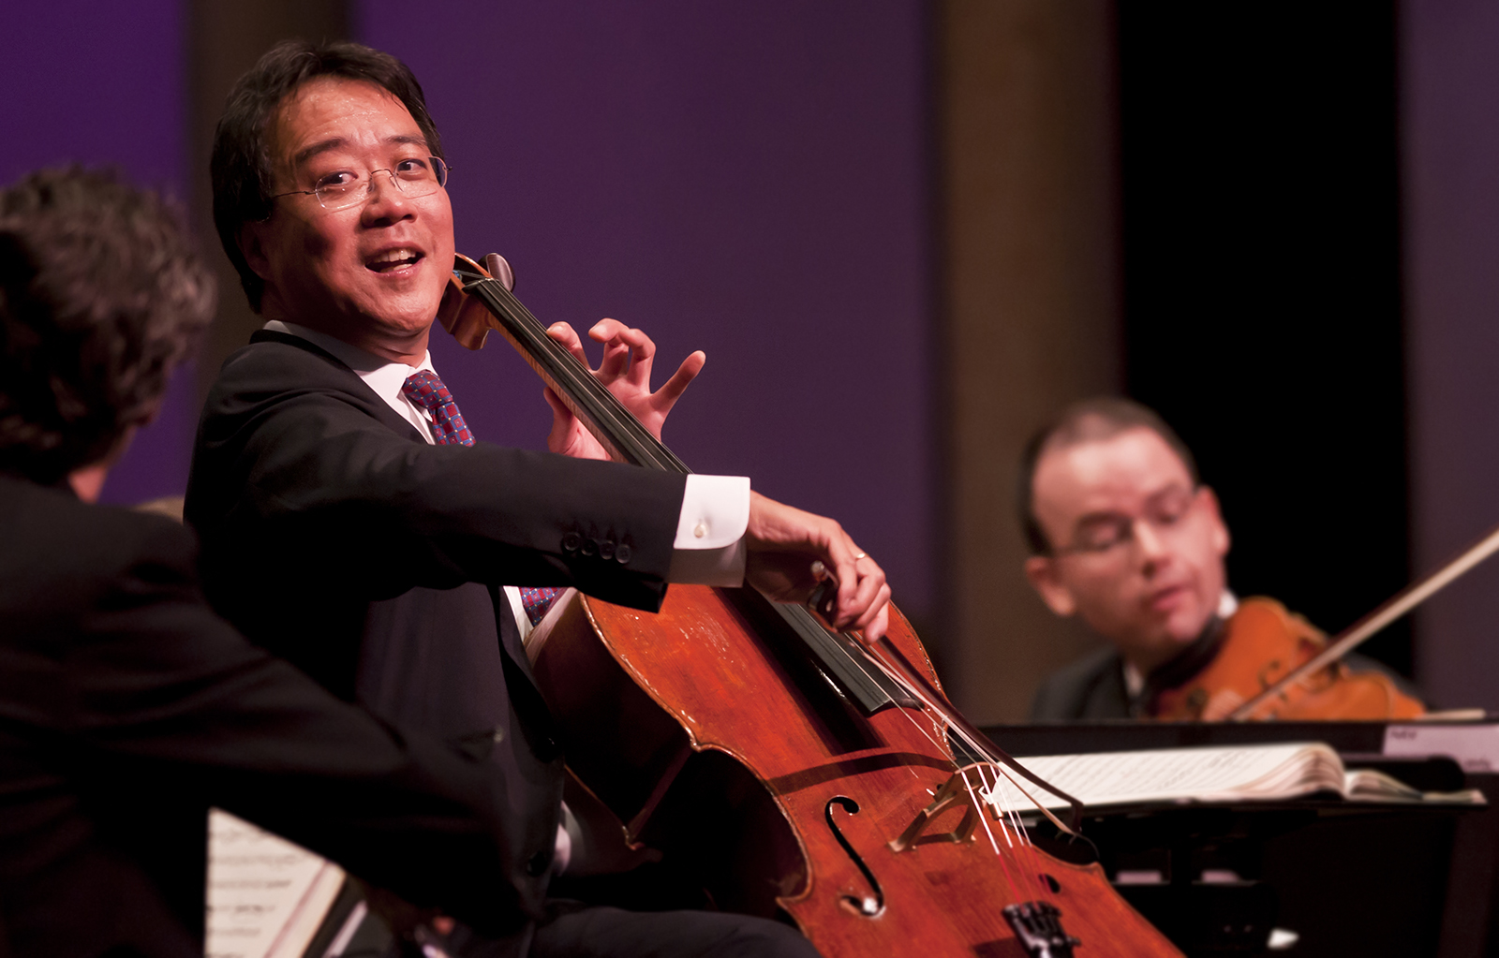
Yo-Yo Ma playing the chello

Slide 3
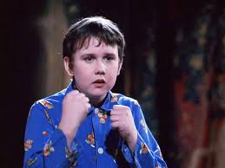
Neville LongbOTom searching his toad(frog)

Slide 4
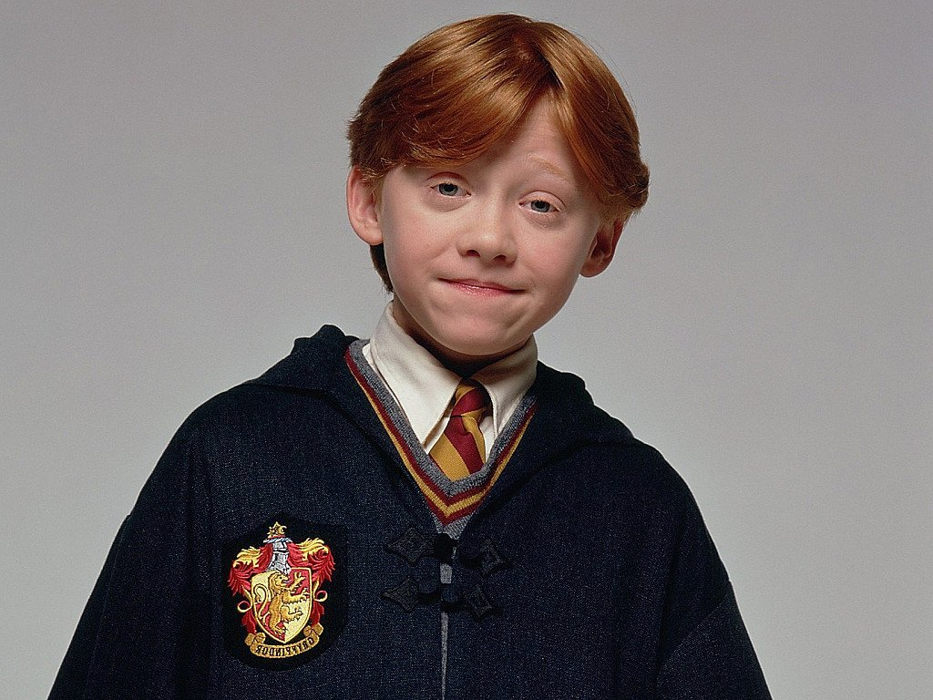
RON Weasley

Slide 5
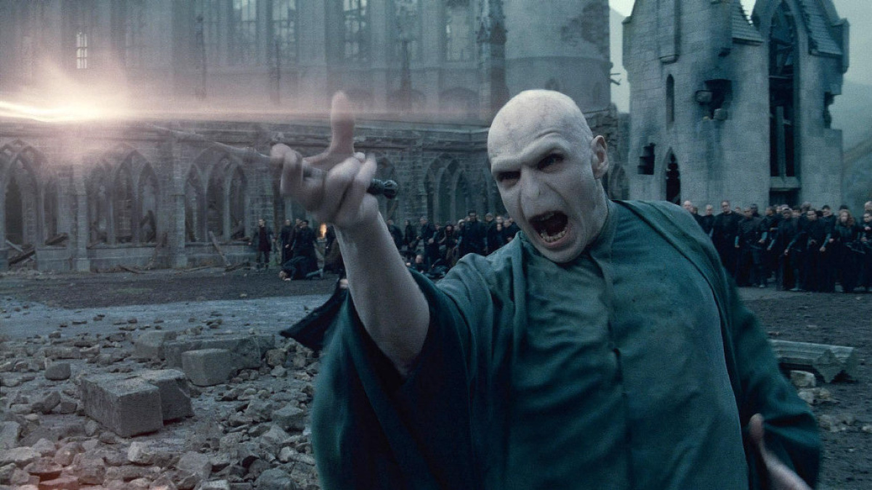
TOM Marvolo Riddle spelling(casting) avadakadabra

Slide 6
T T

Slide 7
o o

Slide 8
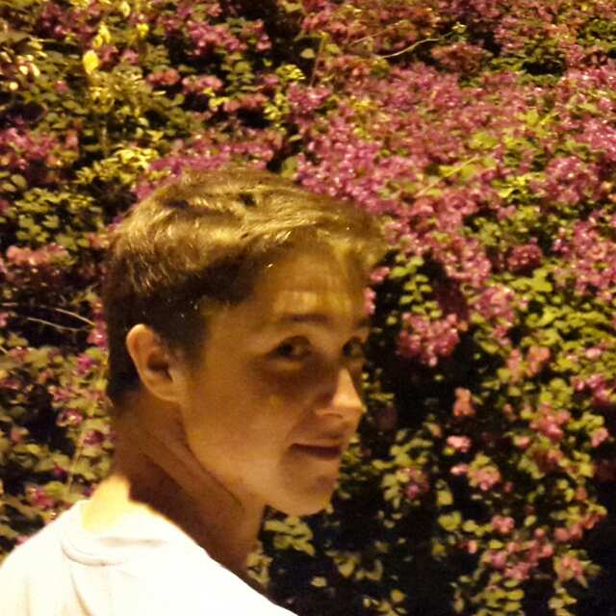
YOSef Obrayan

Slide 9
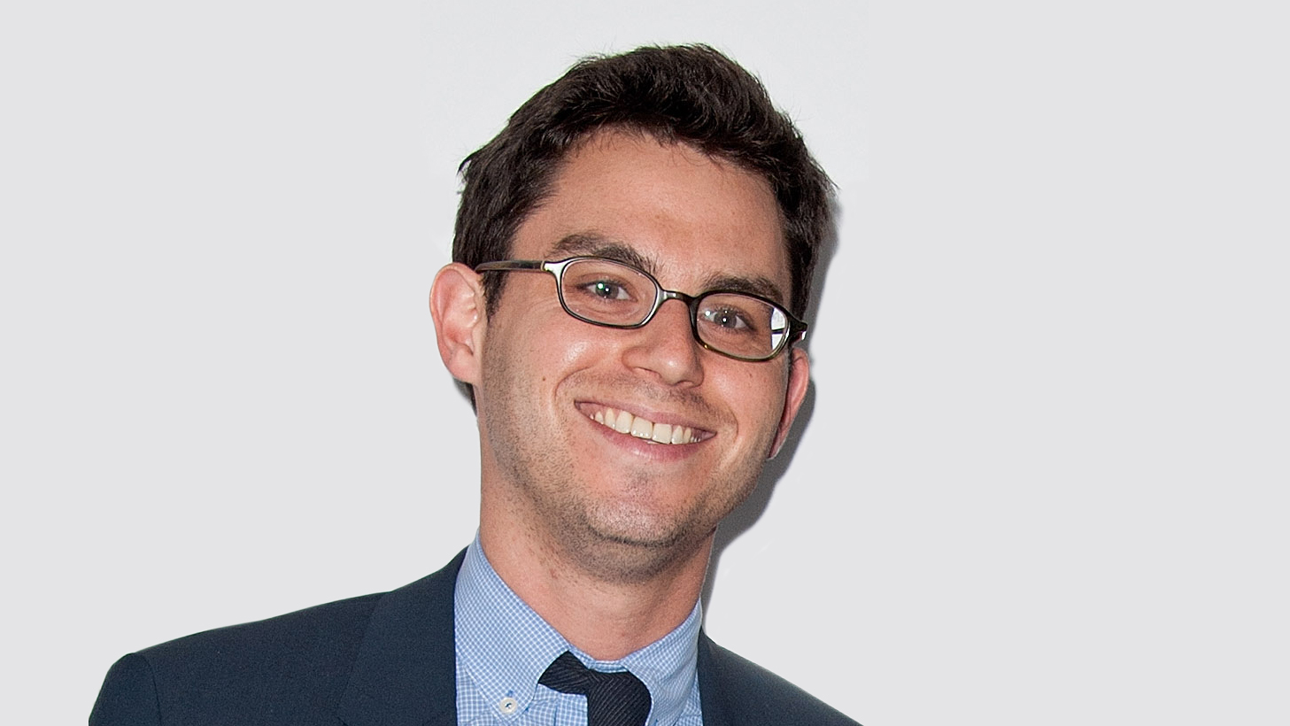
JOsh Foer

Slide 10
OG

Slide 11
OP

Slide 12
TO

Slide 13
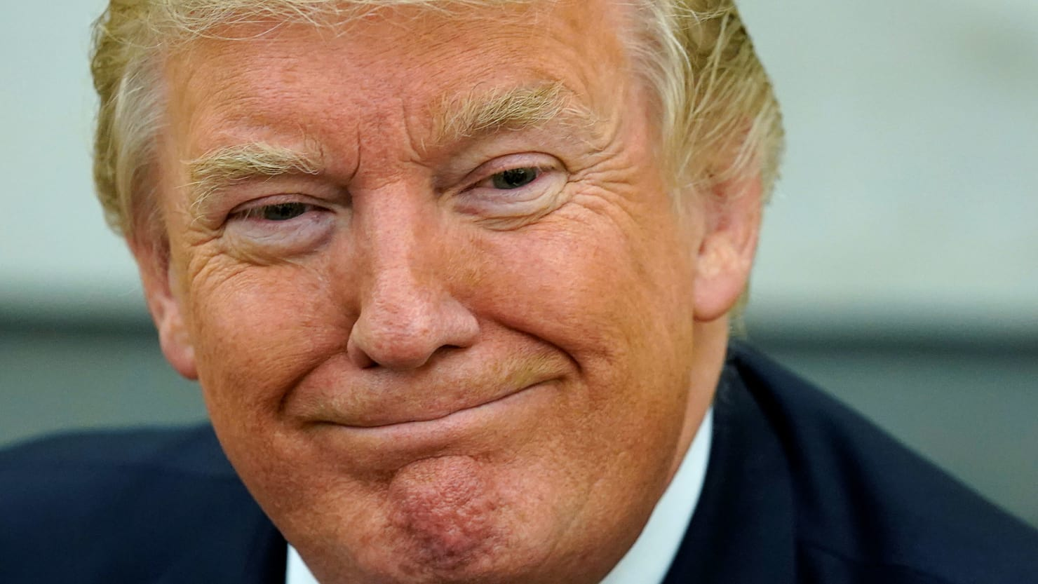
Donald Trump

Slide 14
DN

Slide 15
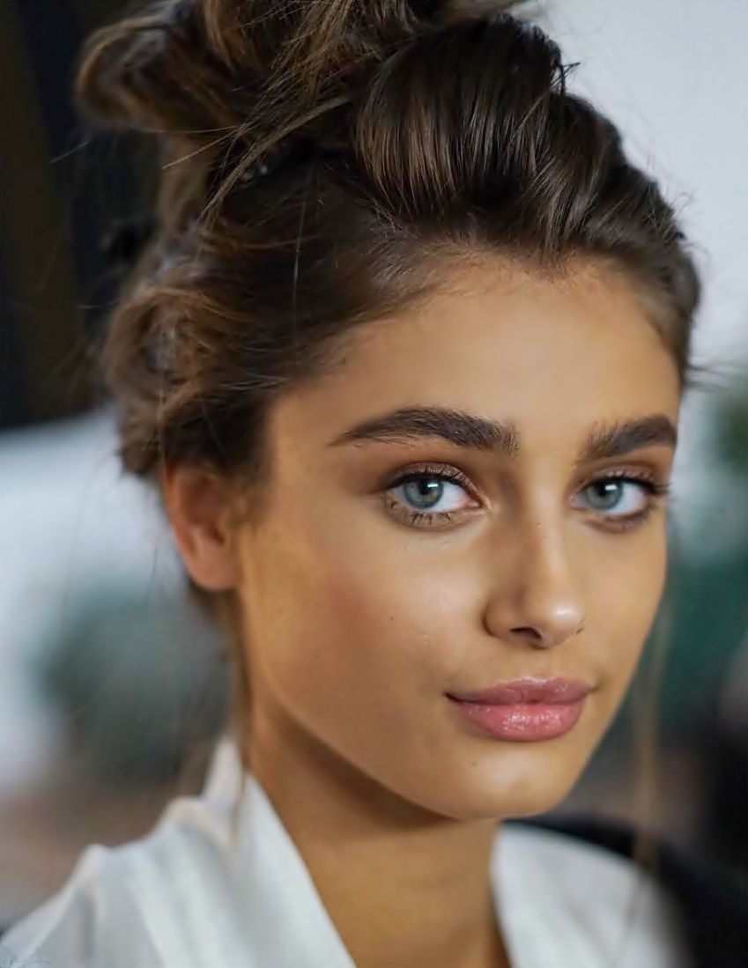
Taylor Marie Hill

Slide 16
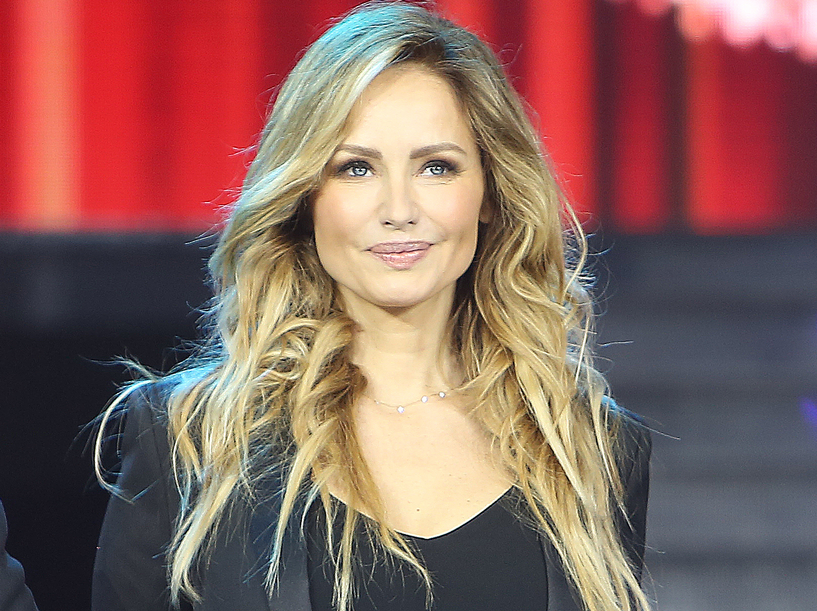
Adriana Karembeu

Slide 17
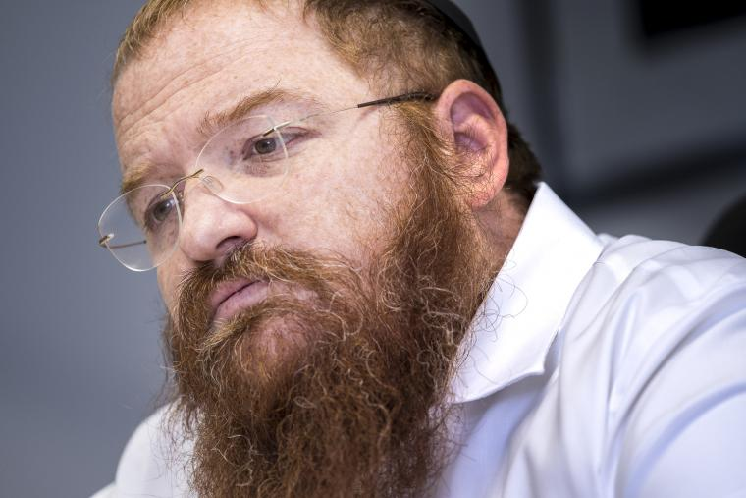
David Libersohn (rab Barcelona)

Slide 18
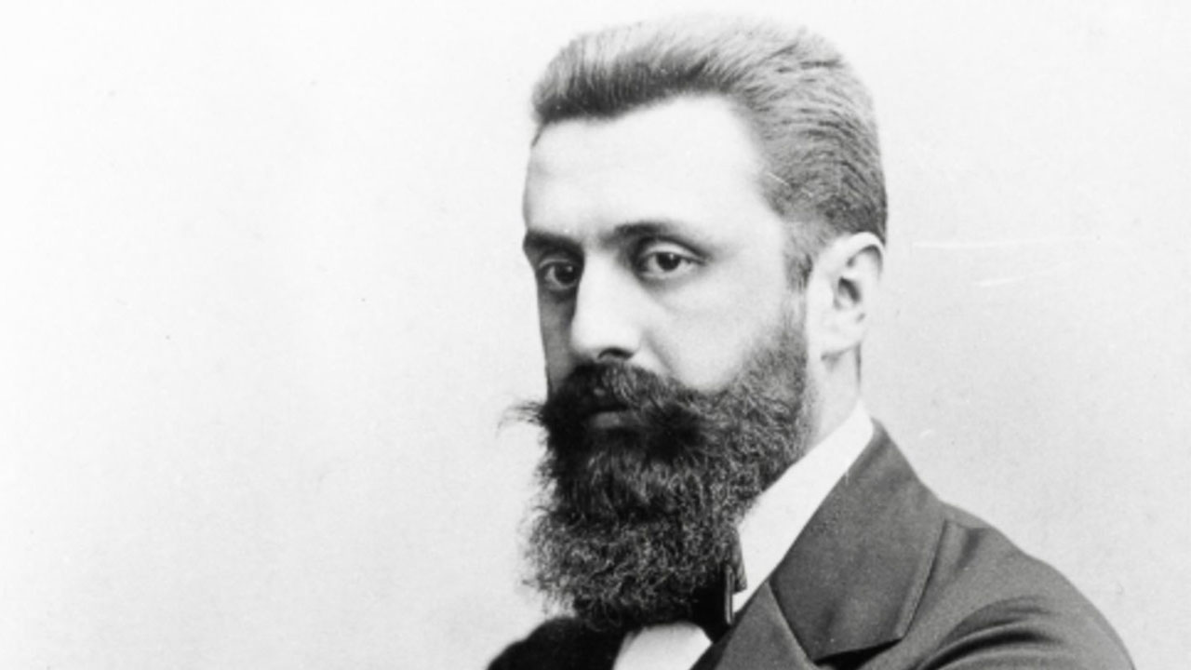
Theodore HerZl

Slide 19
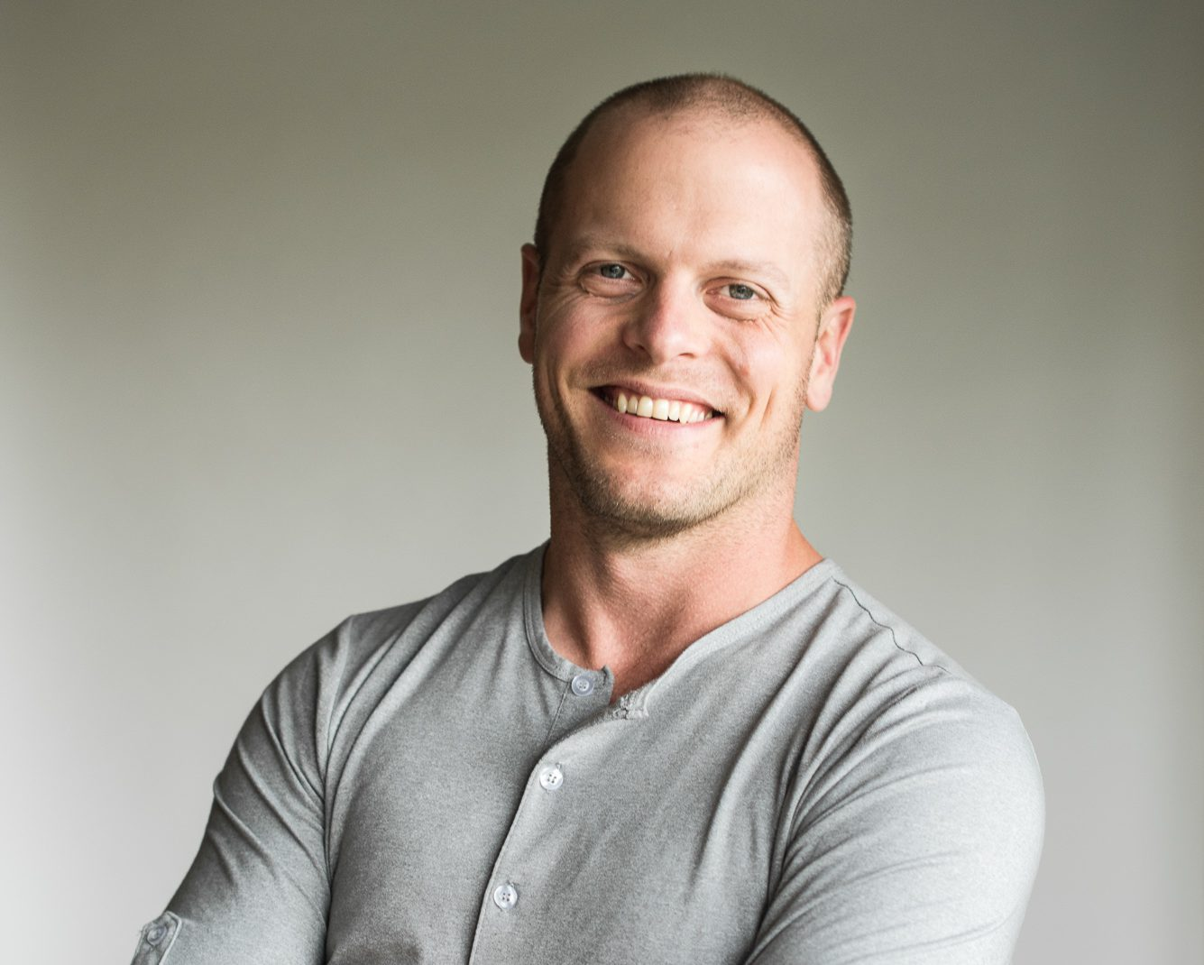
Tim Ferris

Slide 20
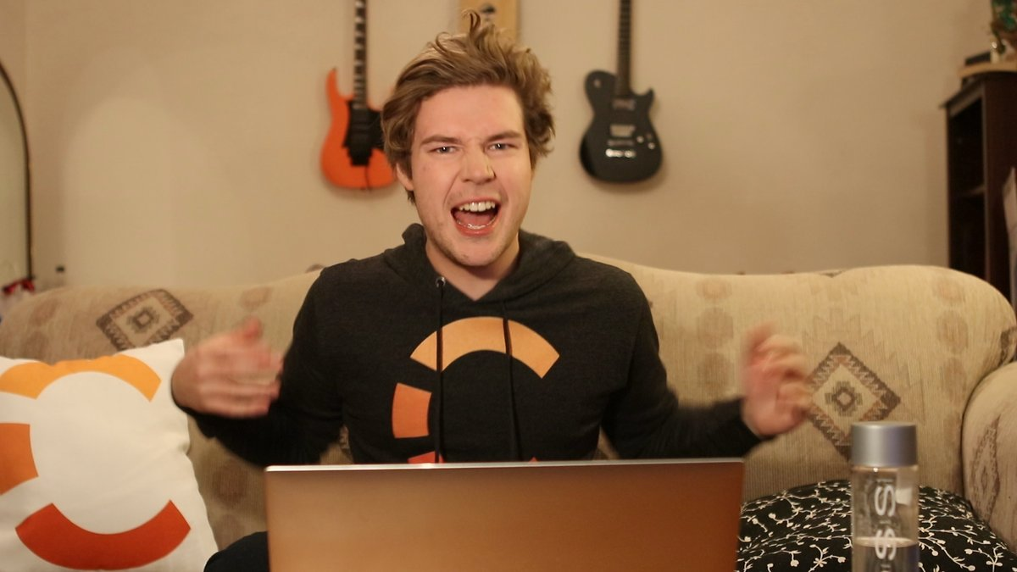
The Cherno

Slide 21
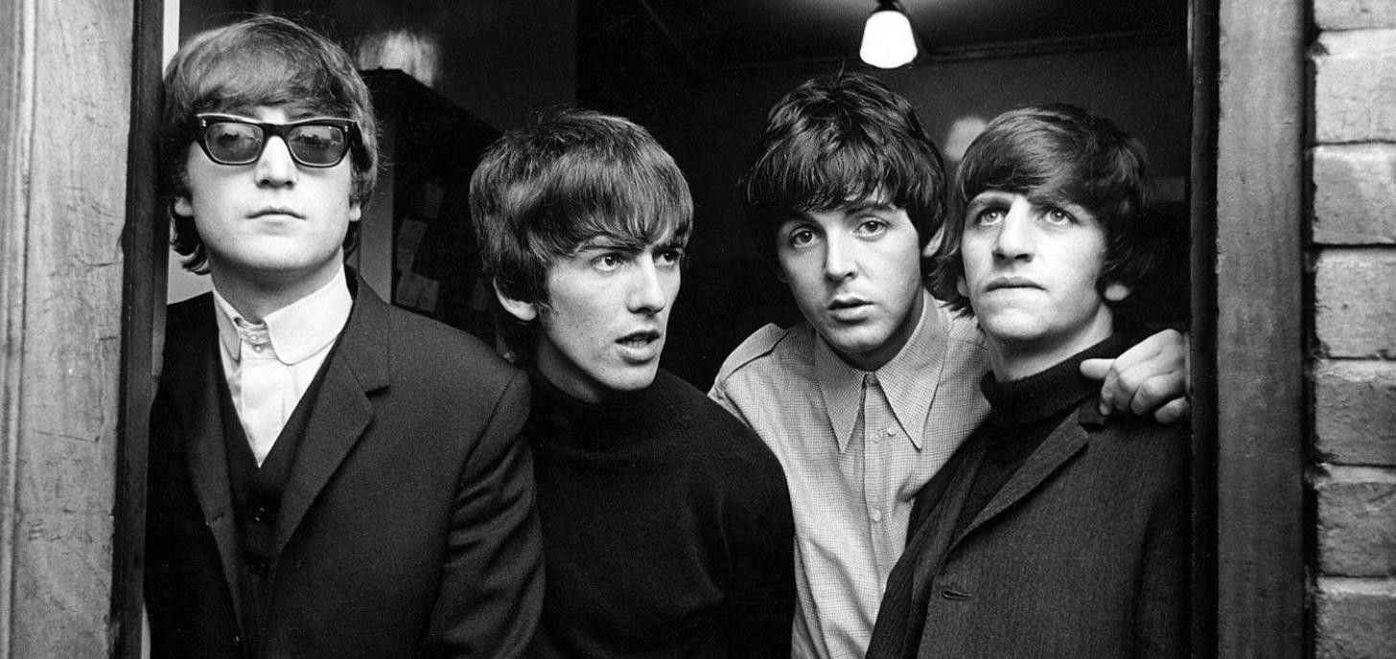
The Beatles

Slide 22
N O

Slide 23
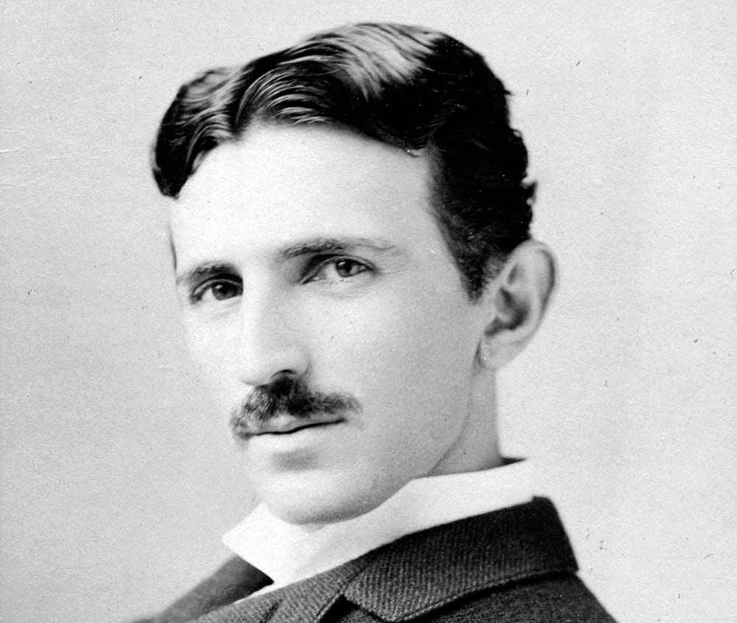
Nikola Tesla

Slide 24
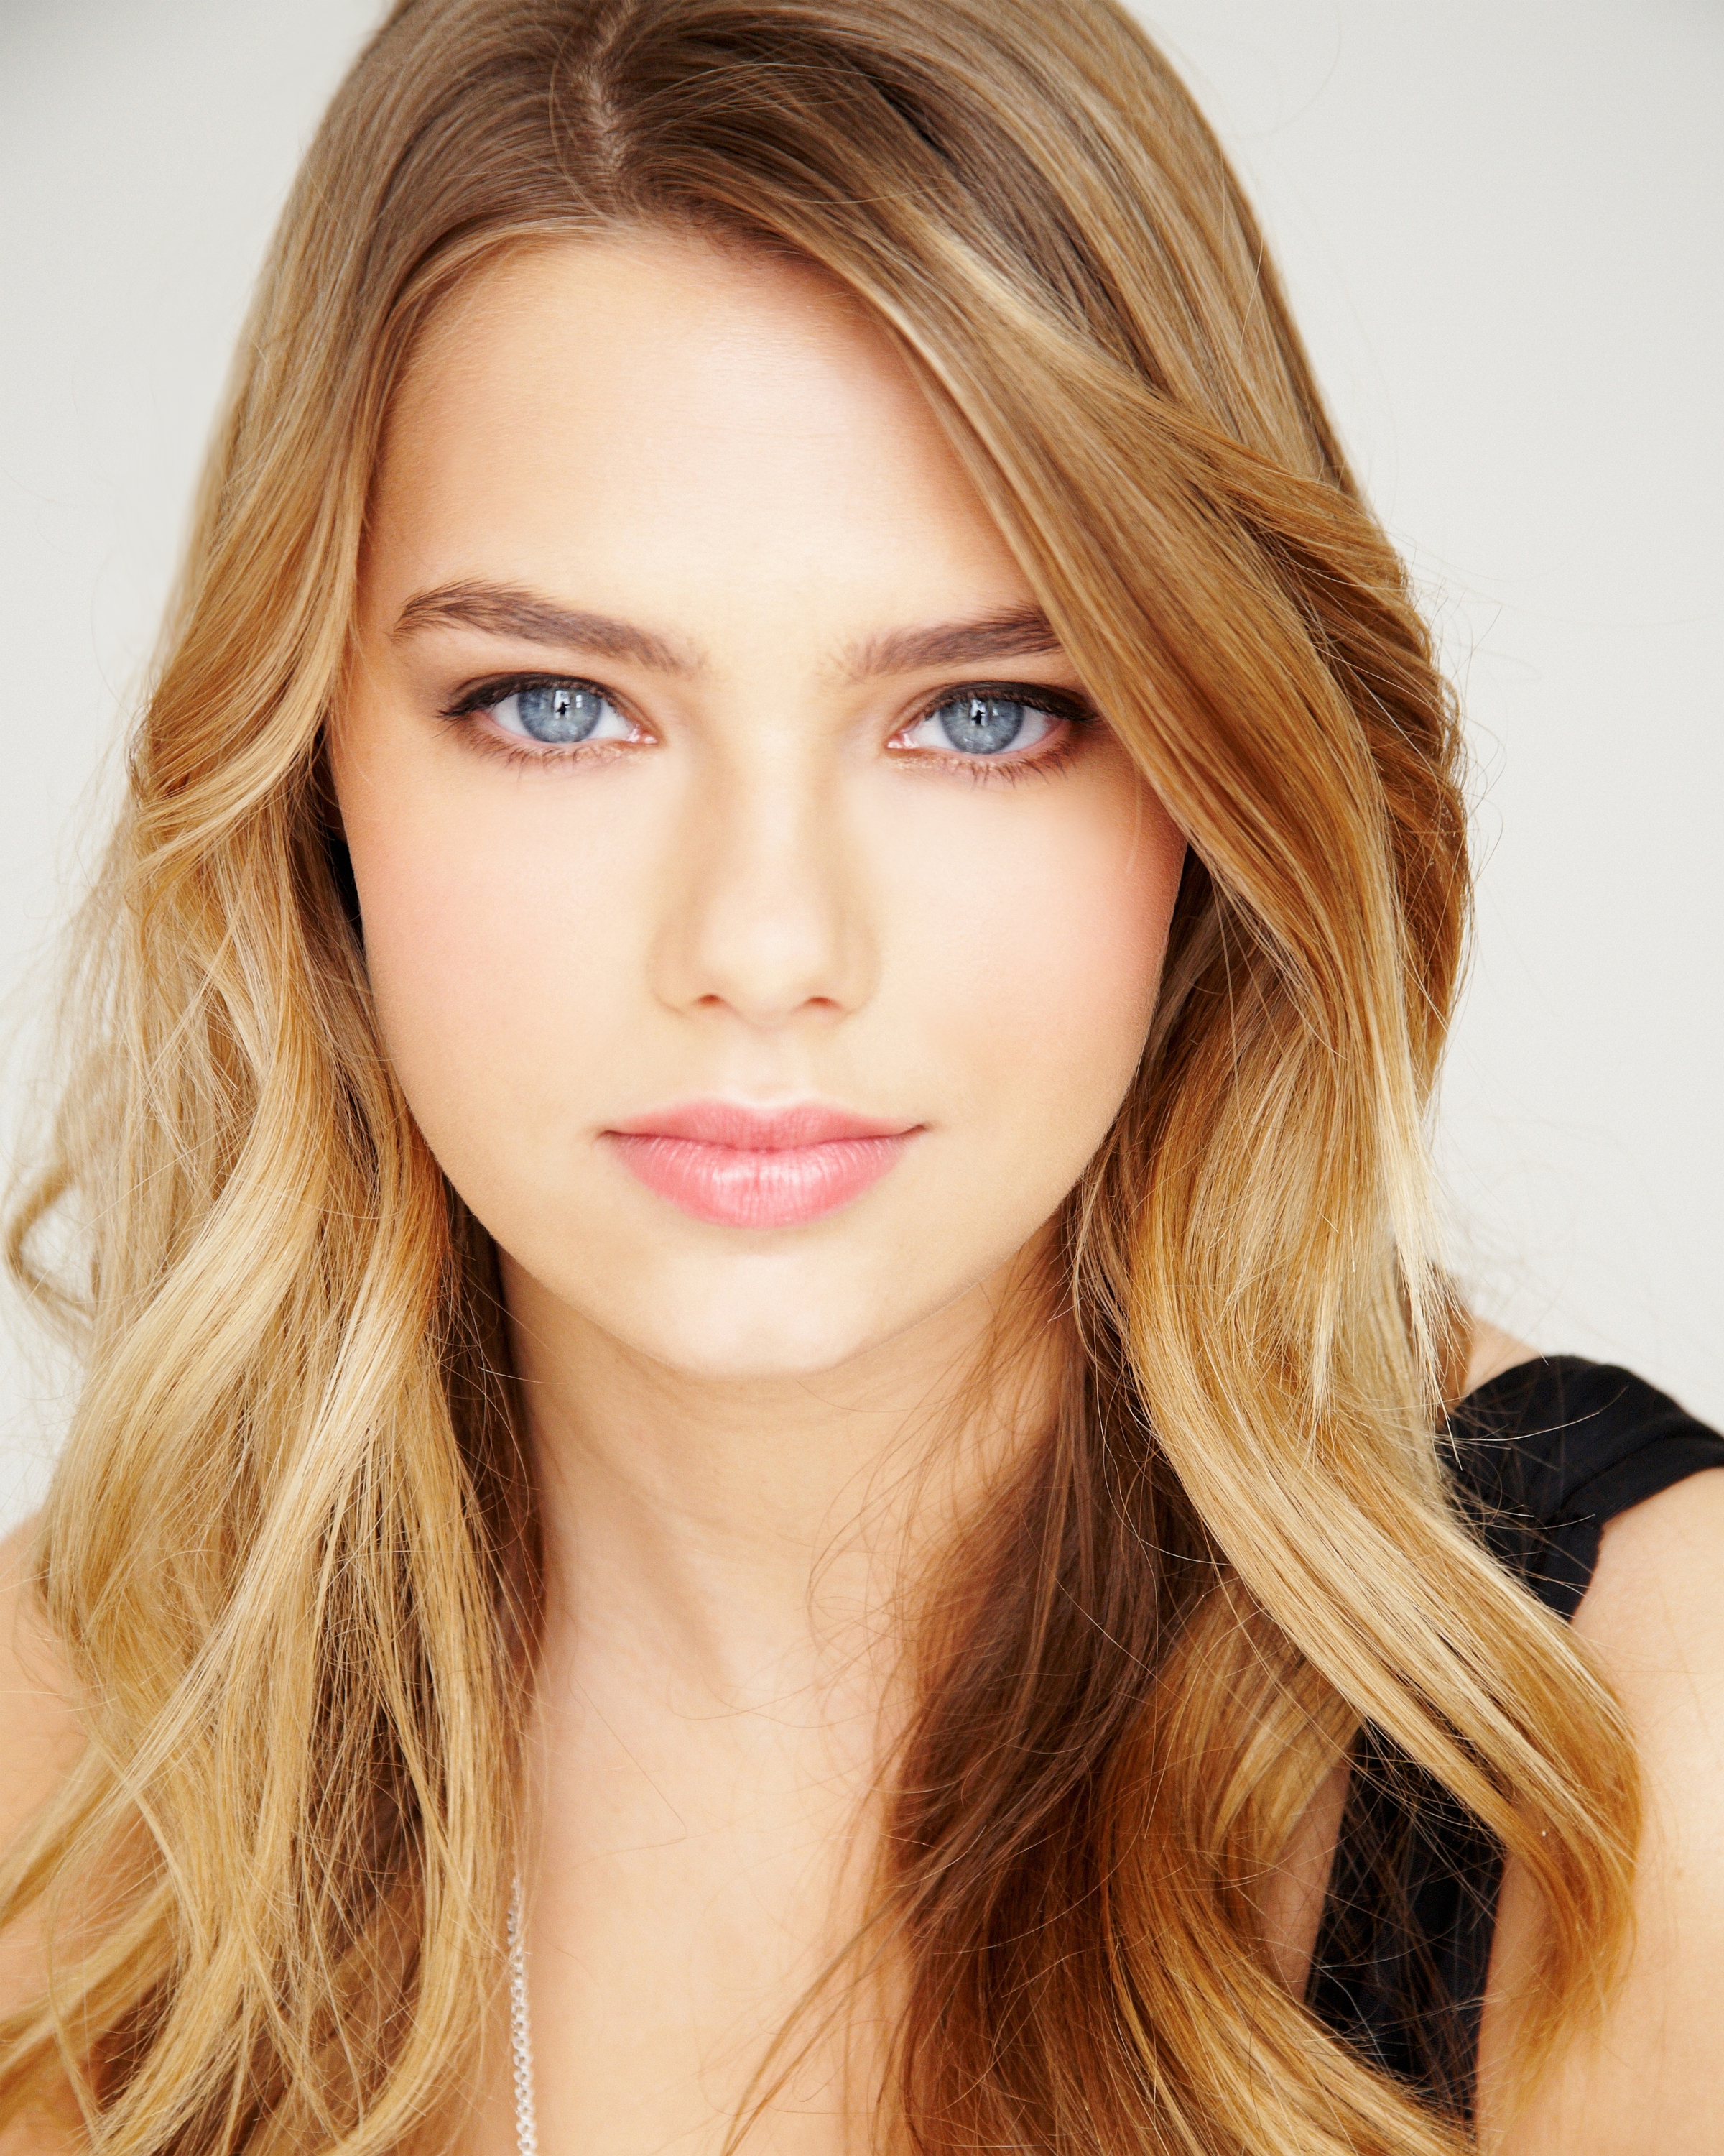
Indiana Evans (H2o Sirenas)

Slide 25
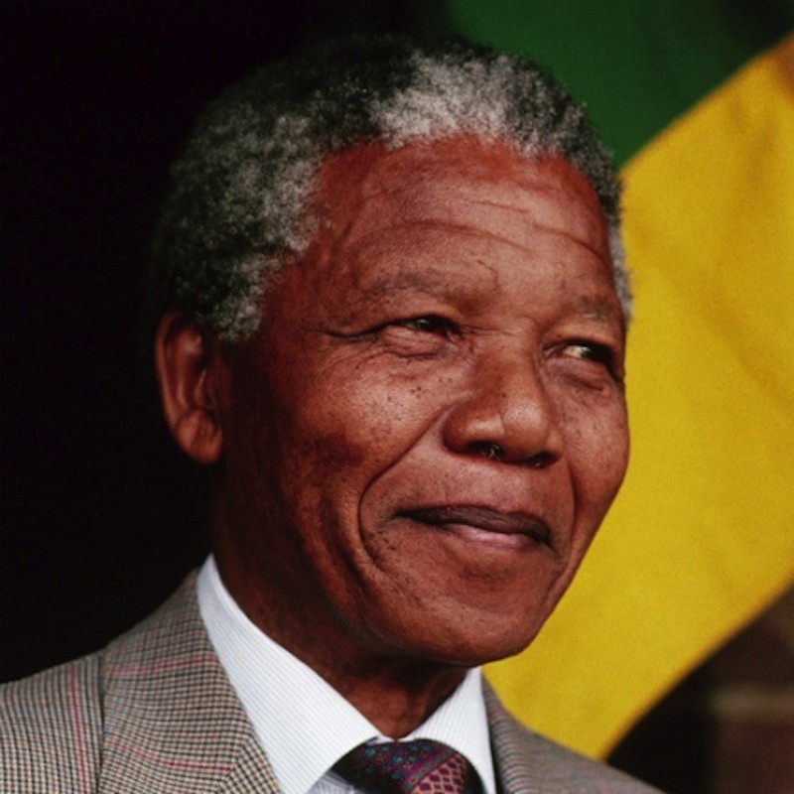
Nelson Mandela

Slide 26
N K

Slide 27
N L

Slide 28
N S

Slide 29
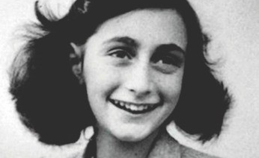
ANNe Frank

Slide 30
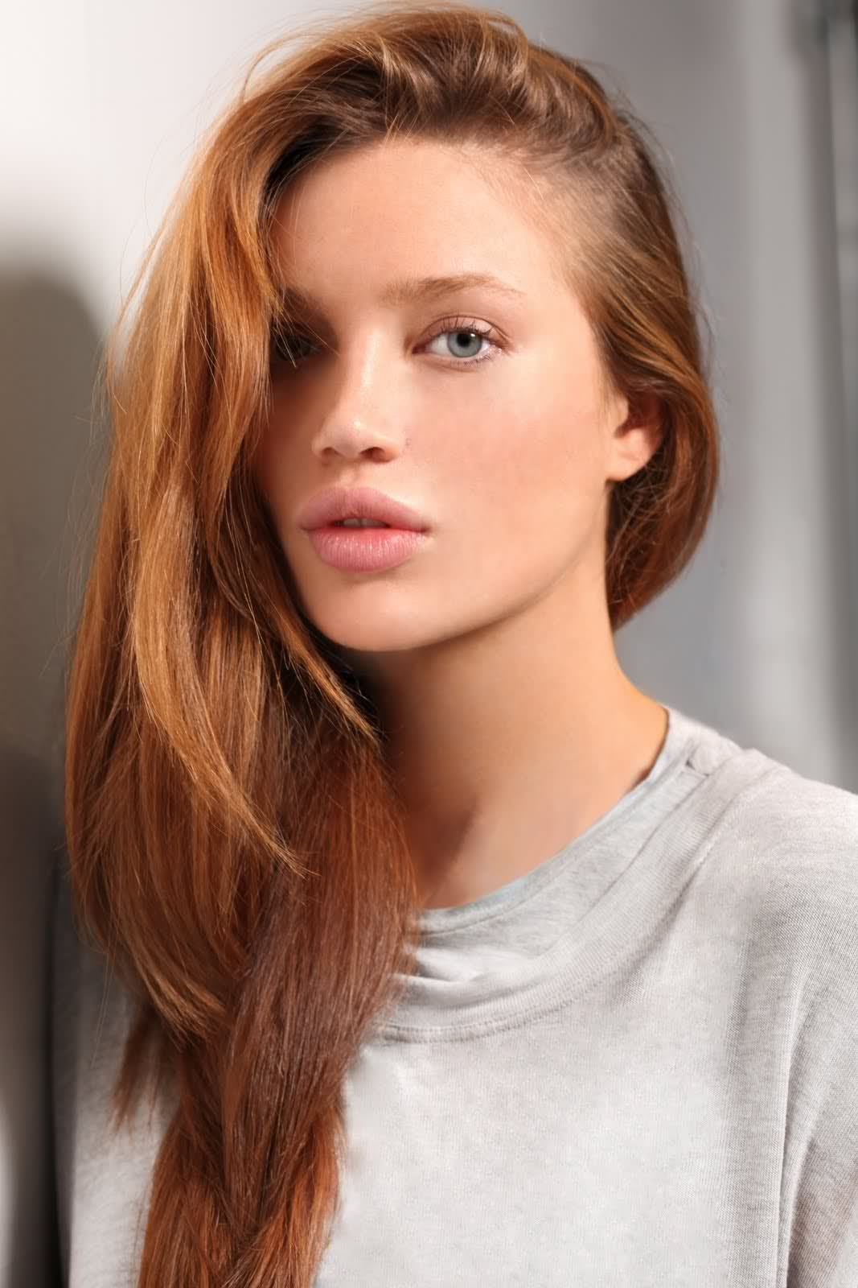
Natalie Gal

Slide 31
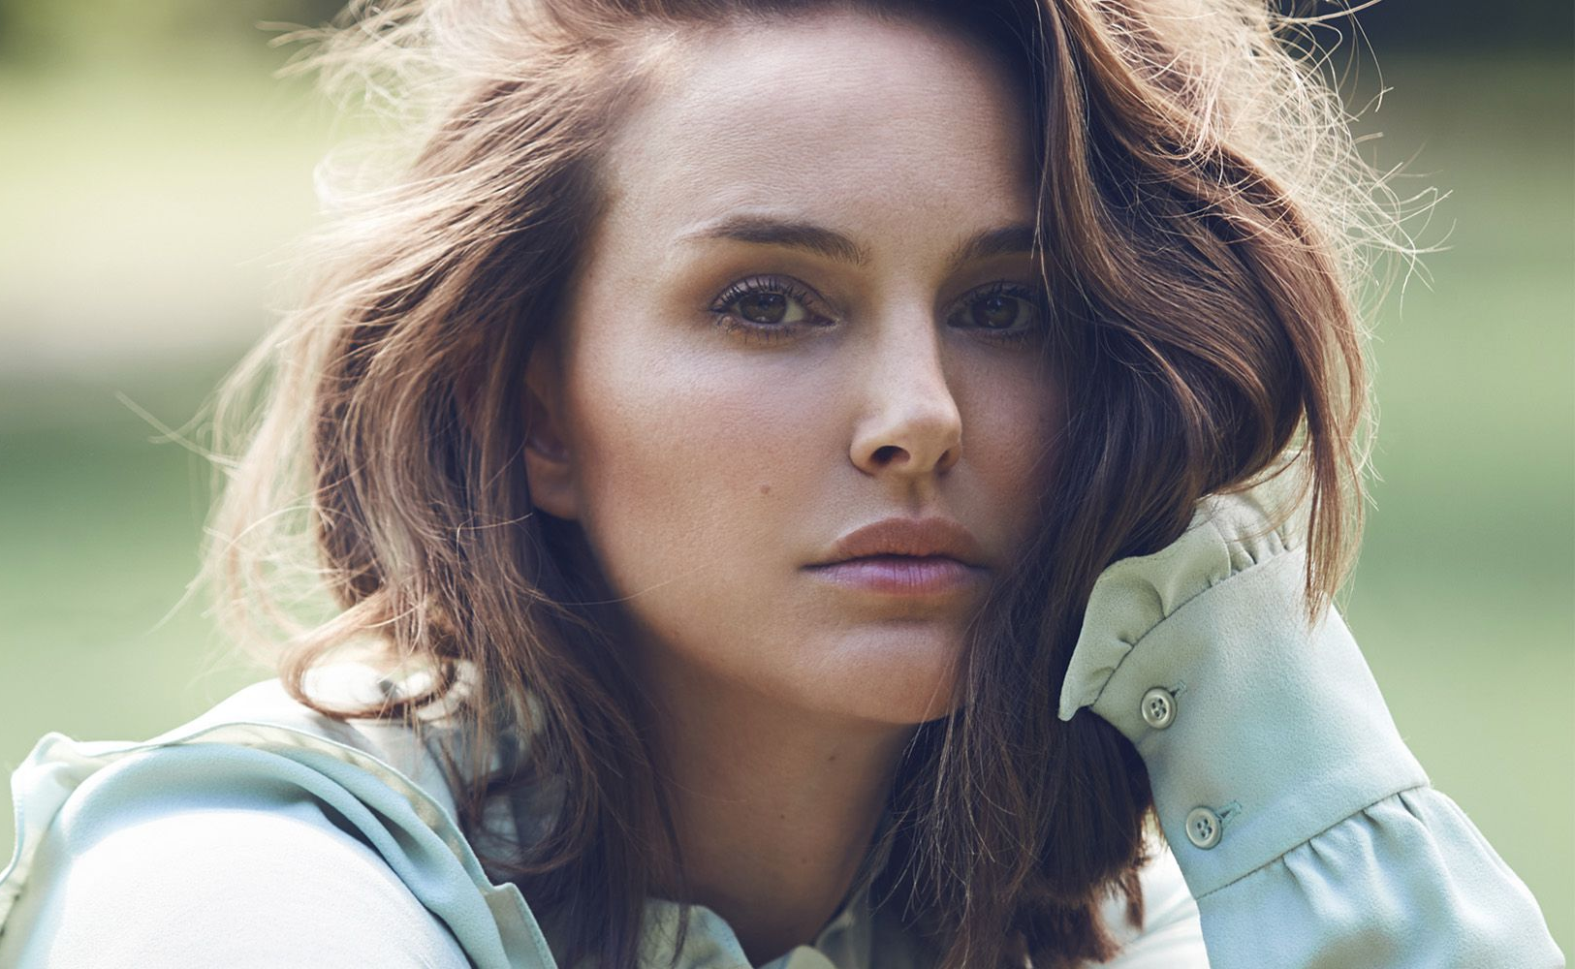
Natalie Portman

Slide 32
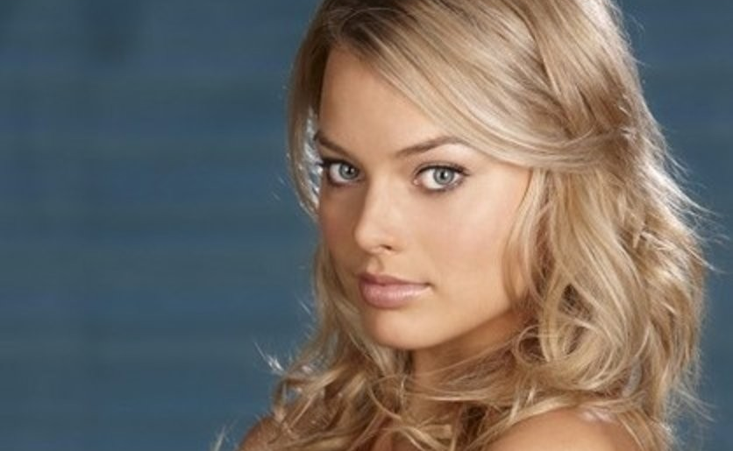
Margot RObbie

Slide 33
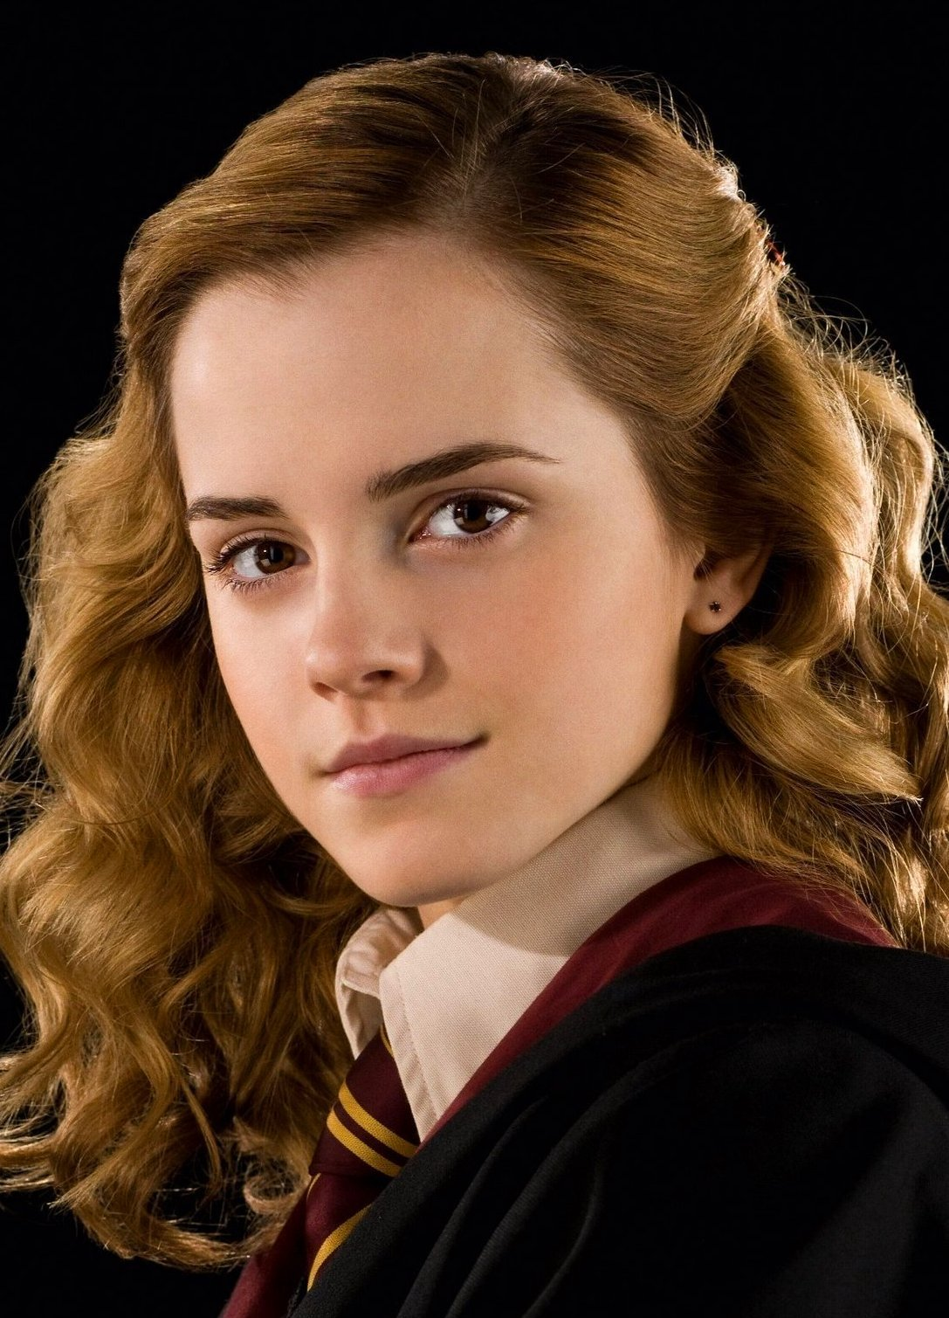
EMMa WaTson

Slide 34
M N

Slide 35
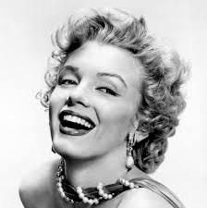
Marilyn Monroe

Slide 36
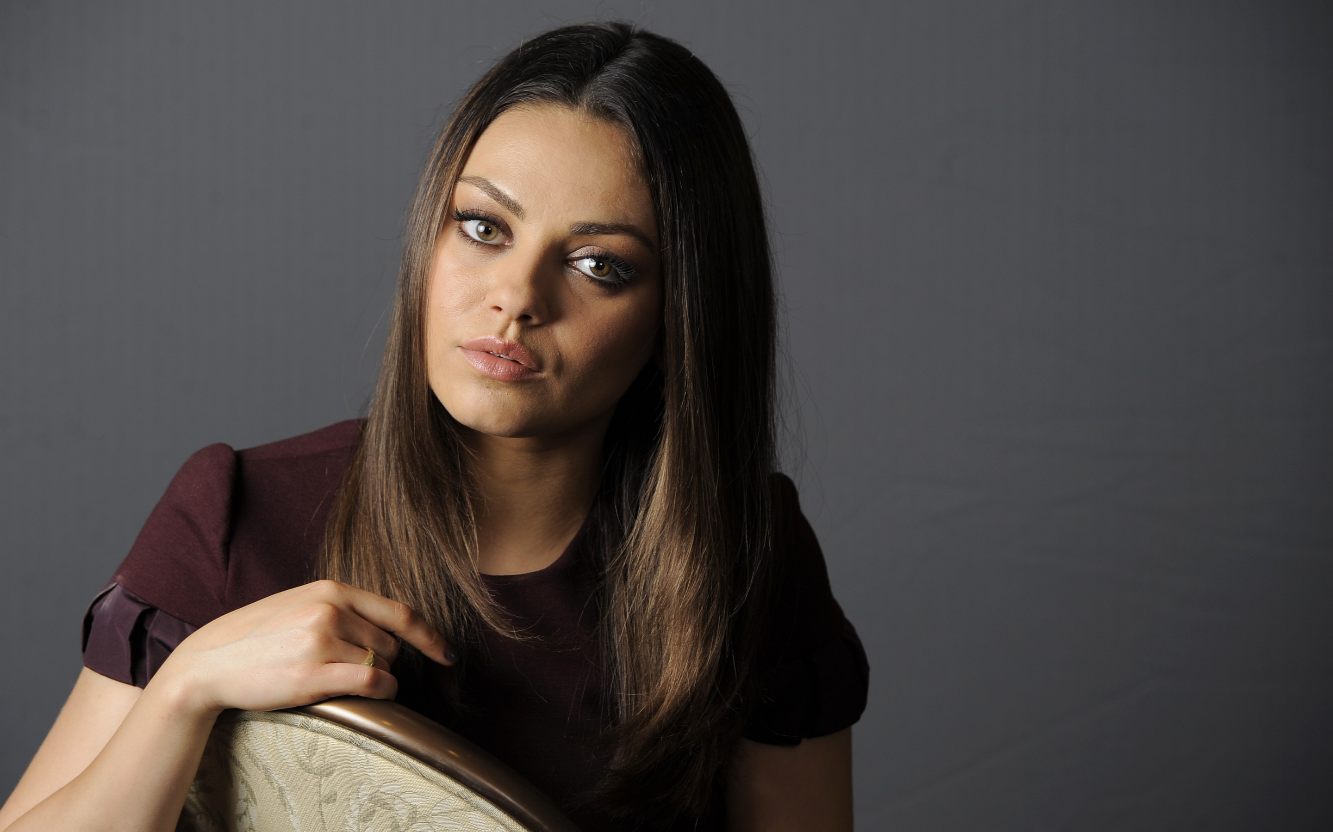
Mila Kunis

Slide 37
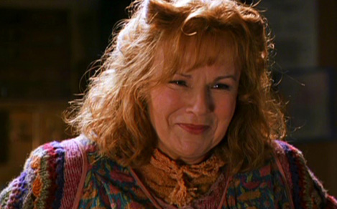
Molly Weasley

Slide 38
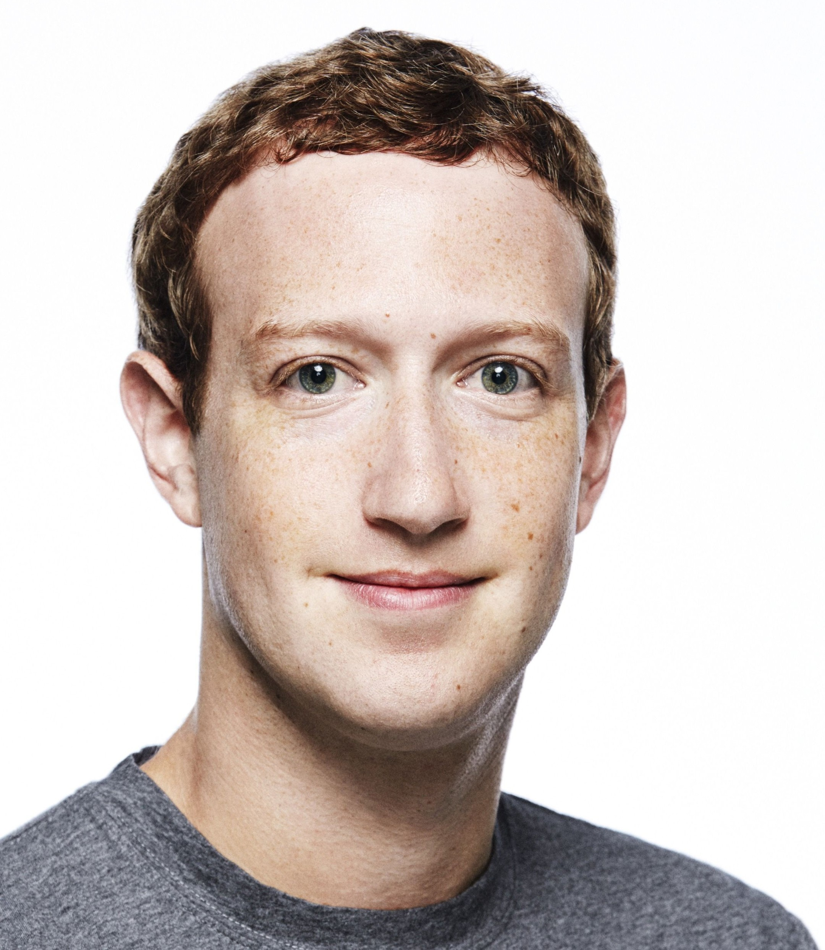
Mark Zuckerberg

Slide 39
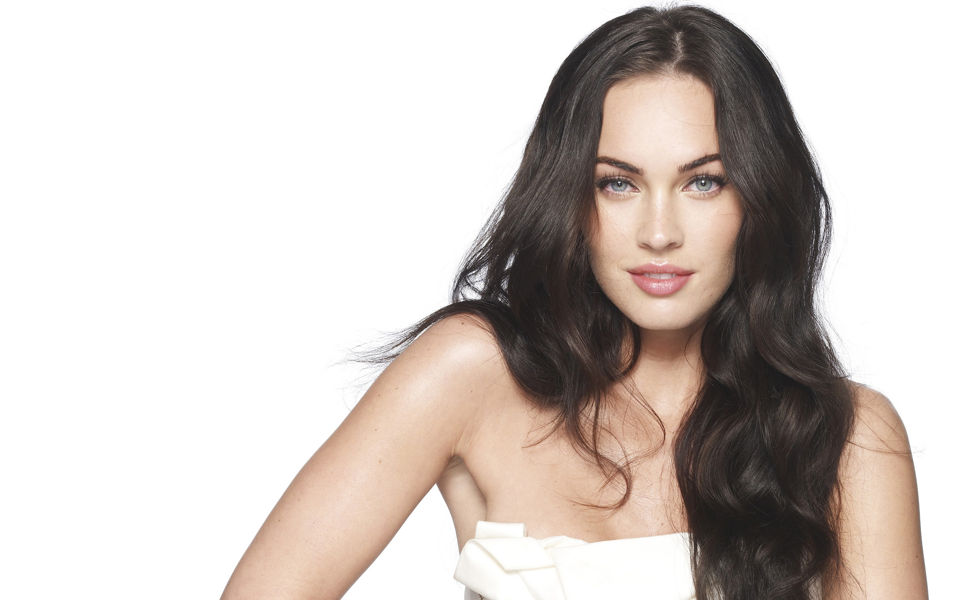
Megan Fox

Slide 40
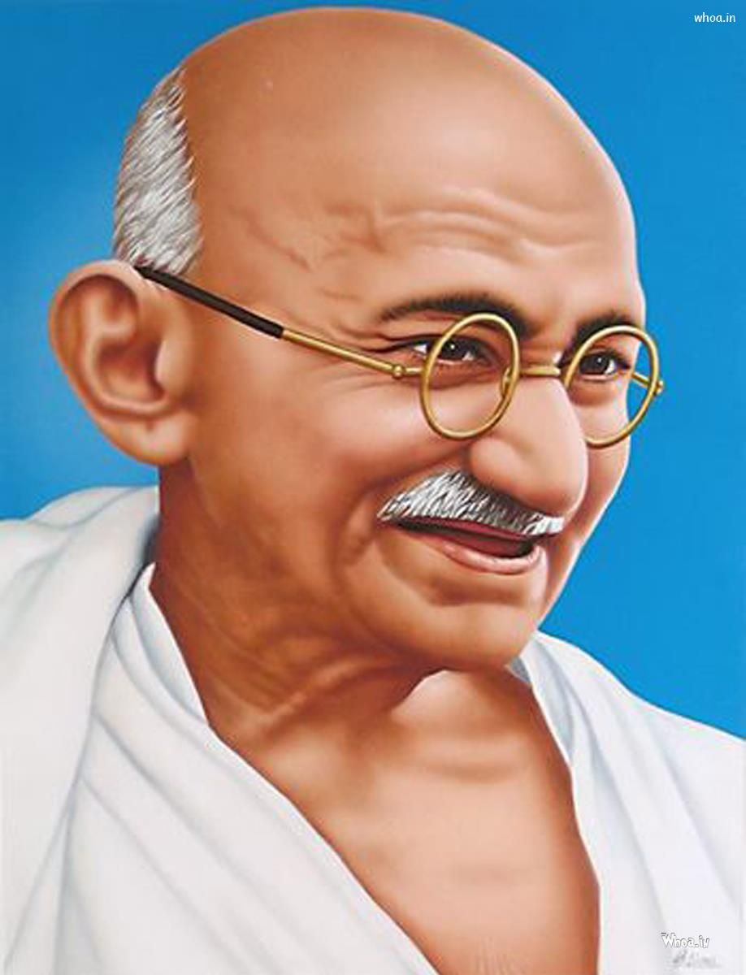
Mahatma Gandhi

Slide 41
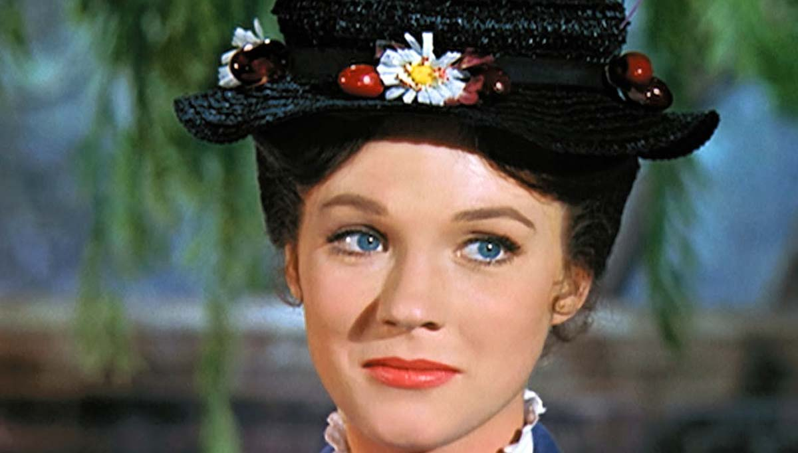
Mary Poppins

Slide 42
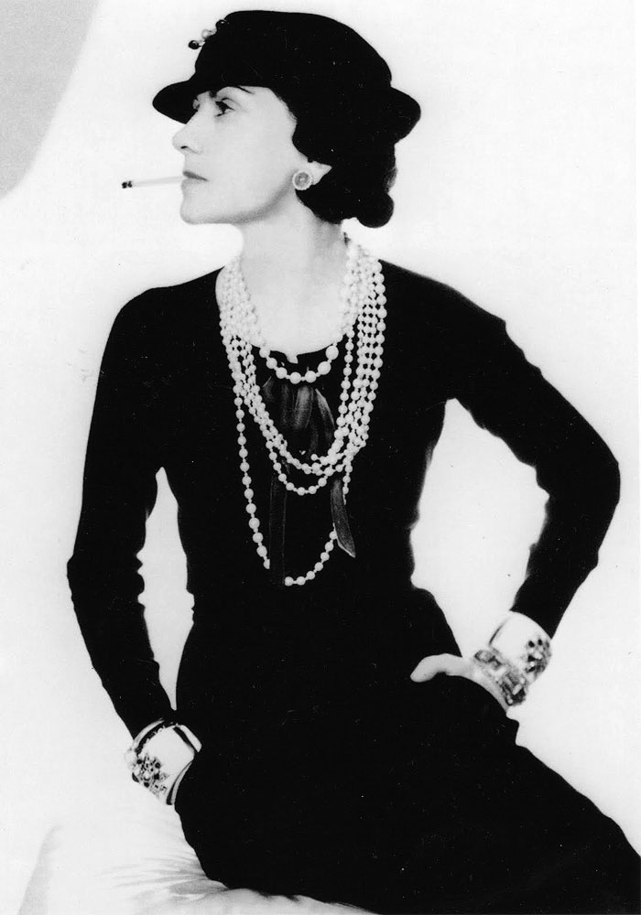
Coco Chanel

Slide 43
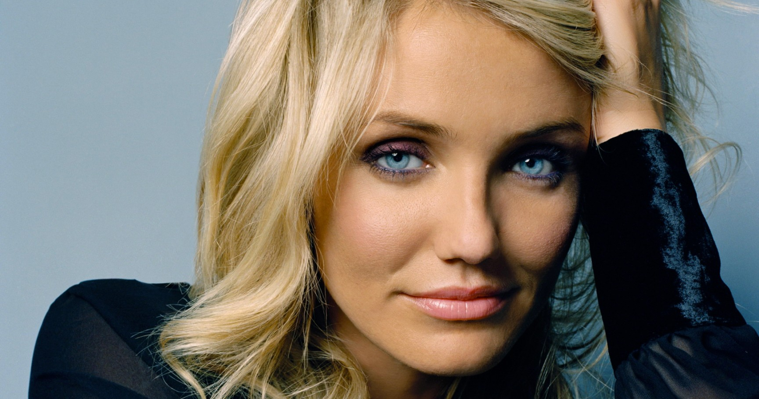
Cameron Diaz

Slide 44
C N

Slide 45
C M

Slide 46
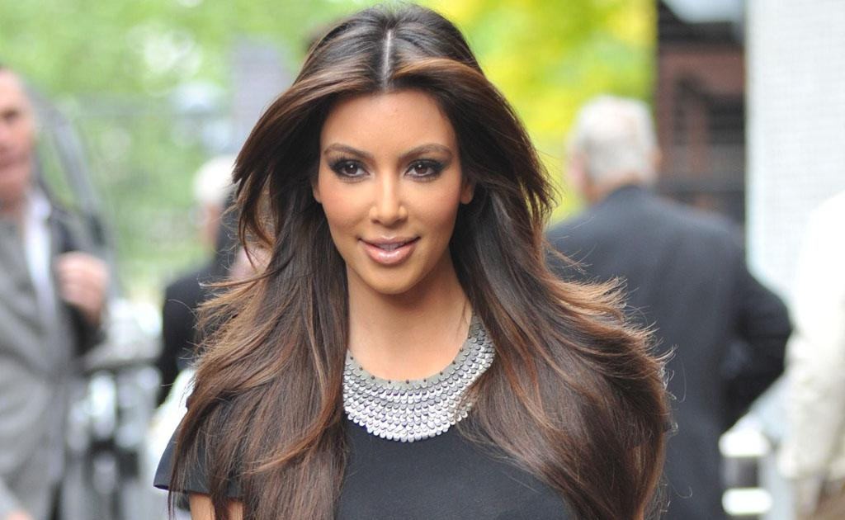
Kim Kardashian

Slide 47
K L

Slide 48
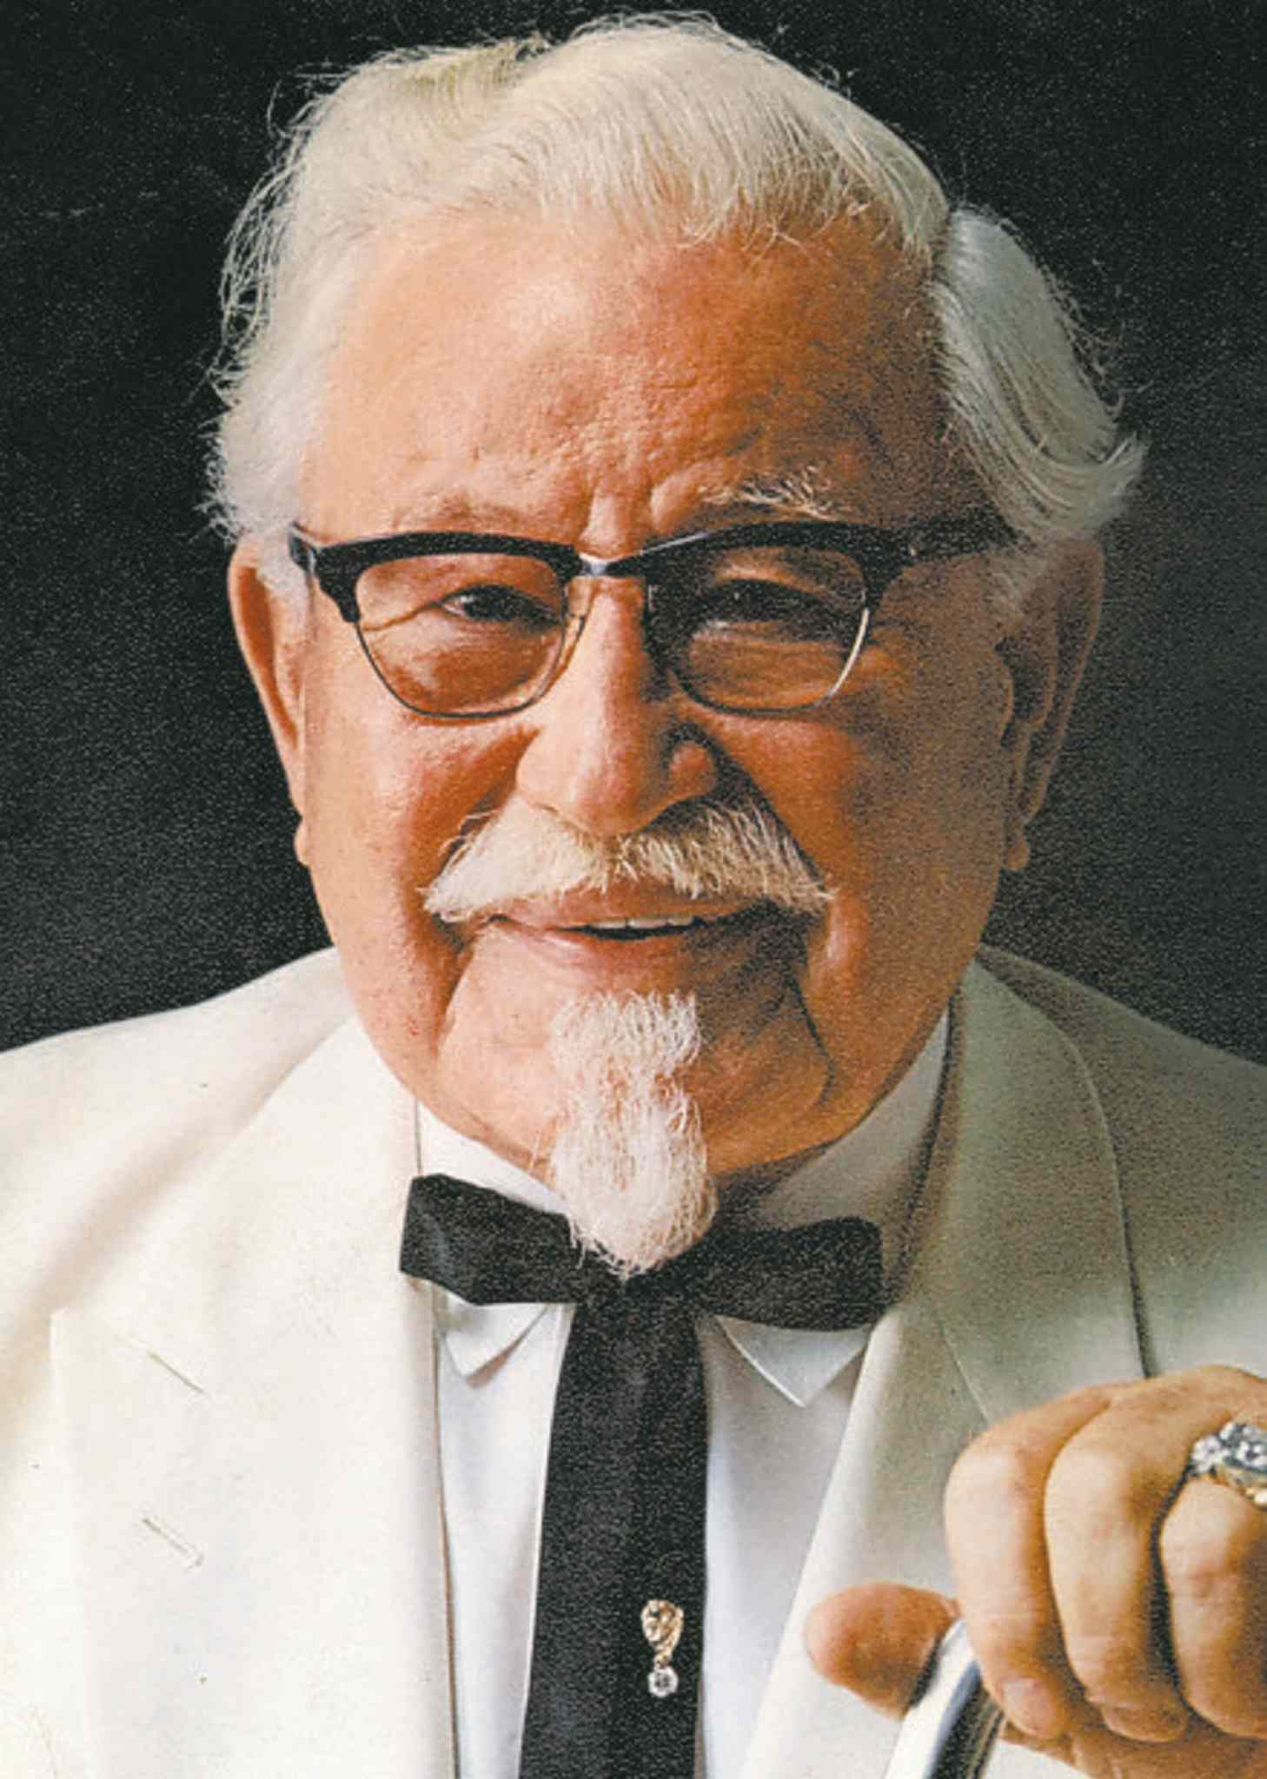
Colonel Sanders

Slide 49
K F

Slide 50
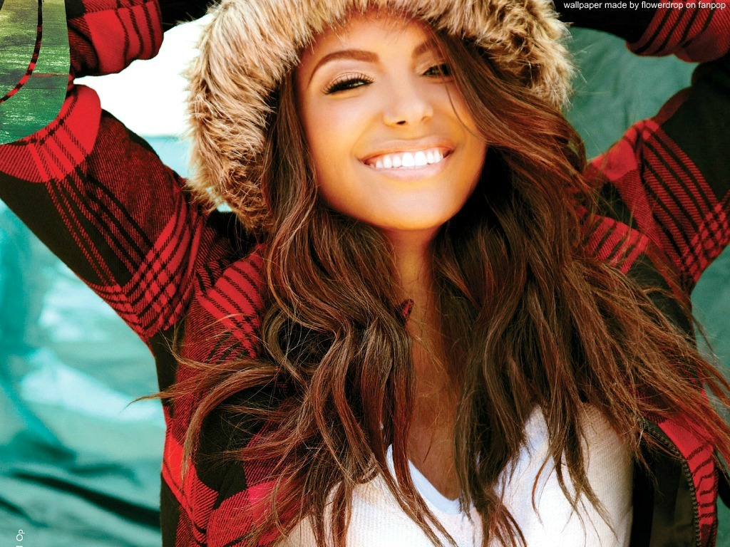
Kat Graham

Slide 51
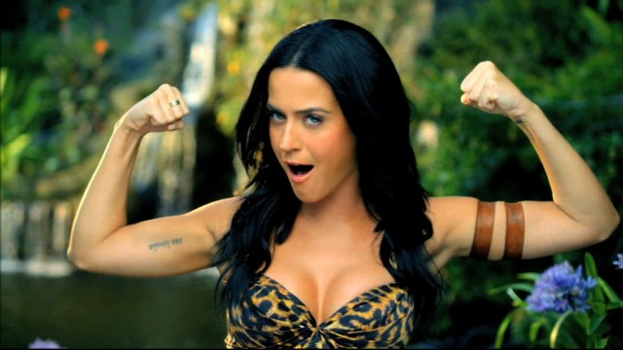
Katy Perry

Slide 52
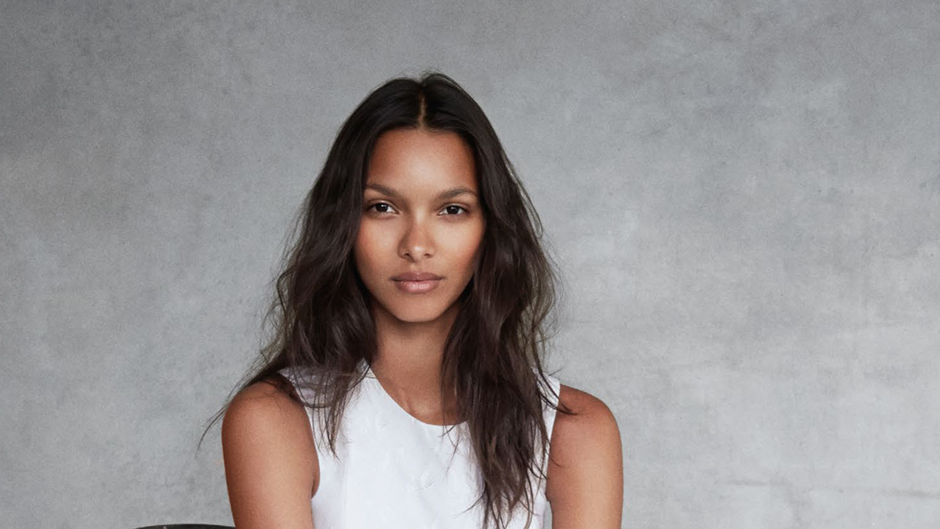
Lais RibeirO

Slide 53
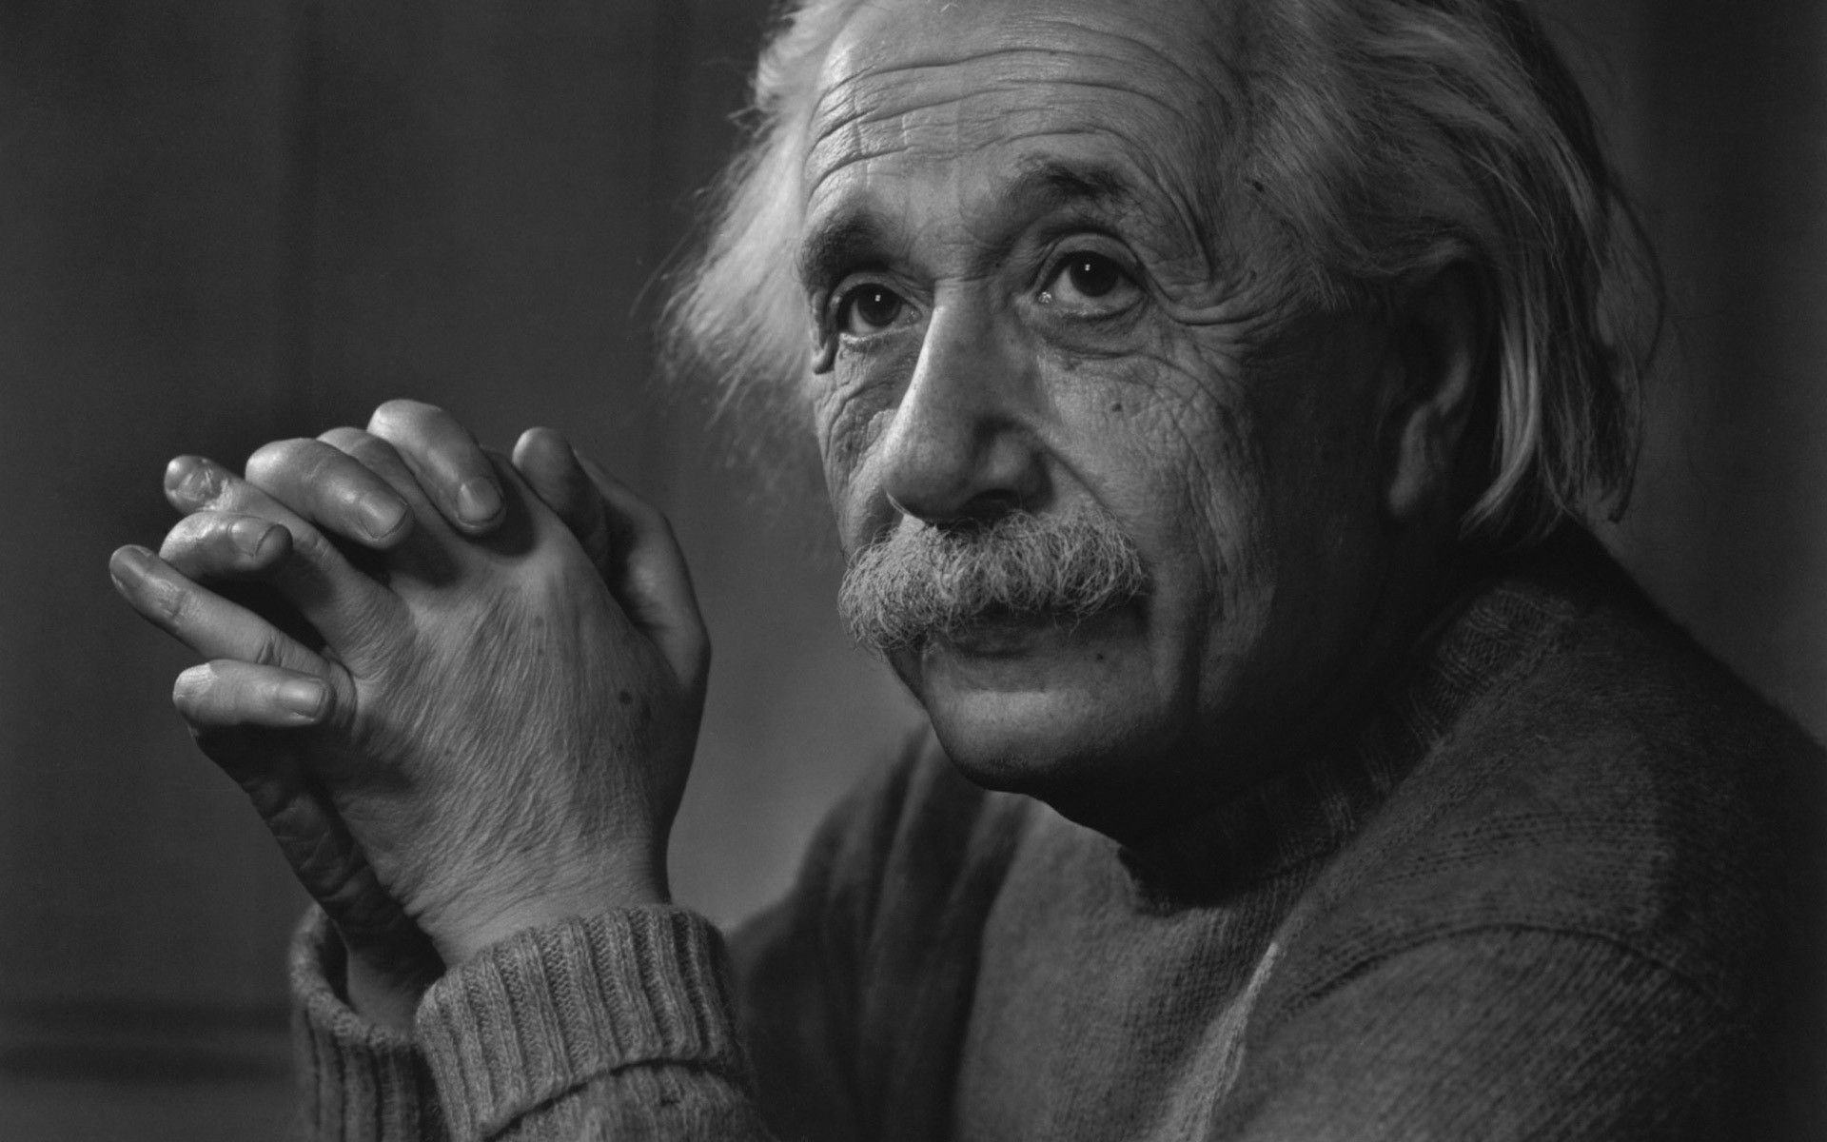
Albert Einstein

Slide 54
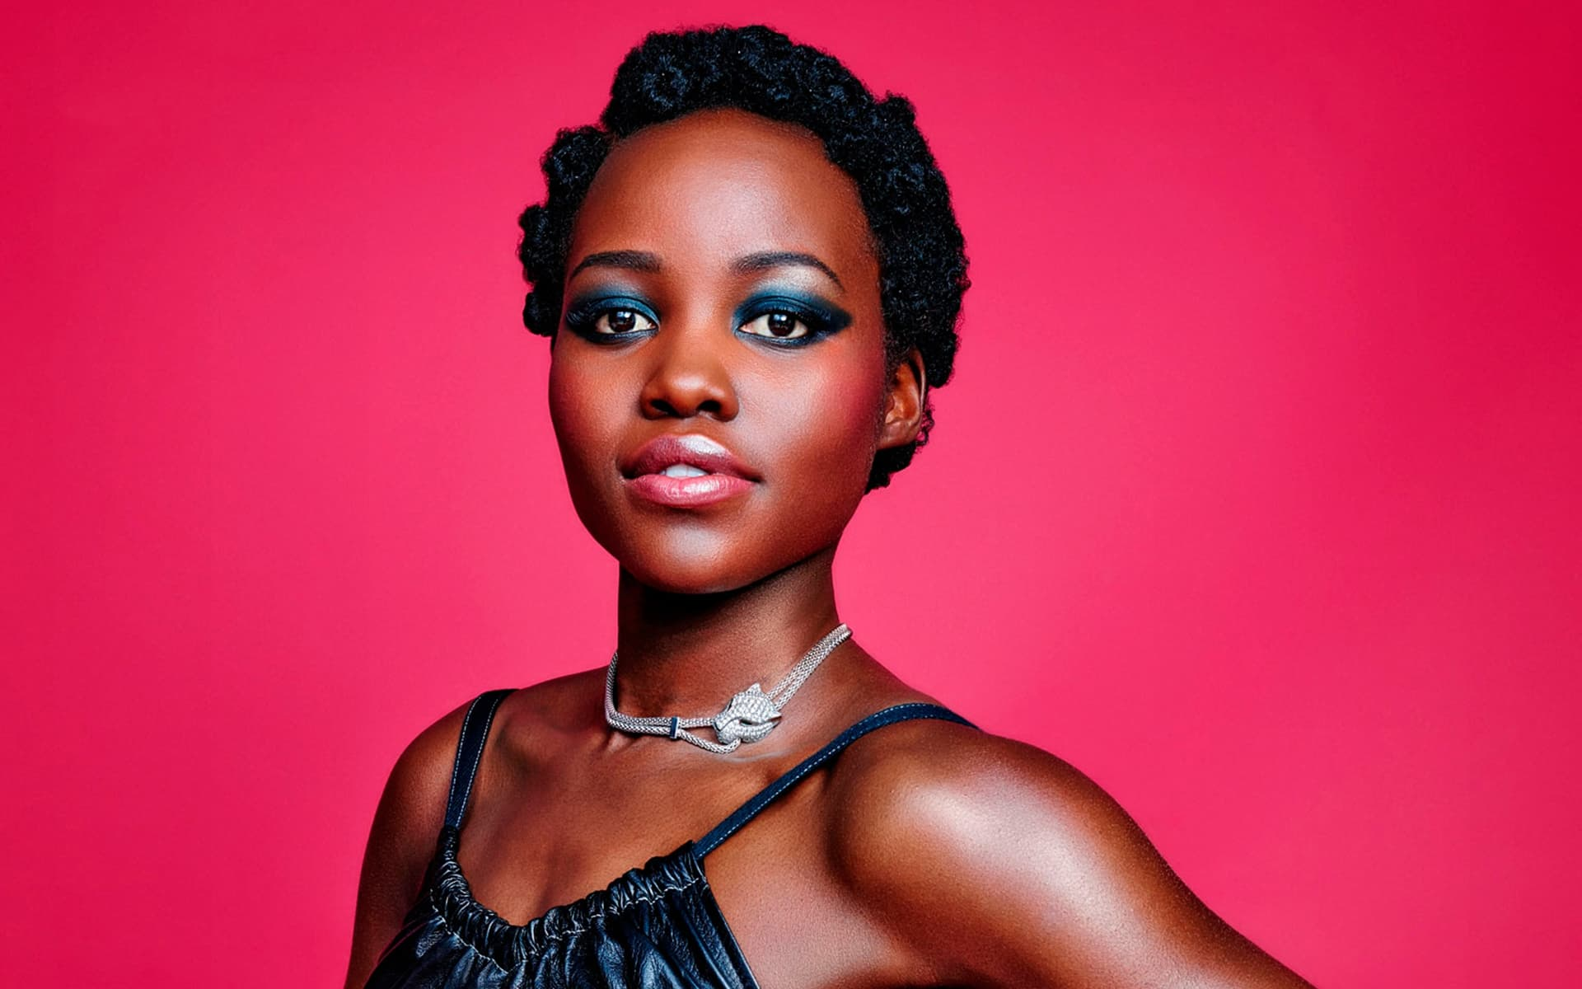
Lupita Nyong'o

Slide 55
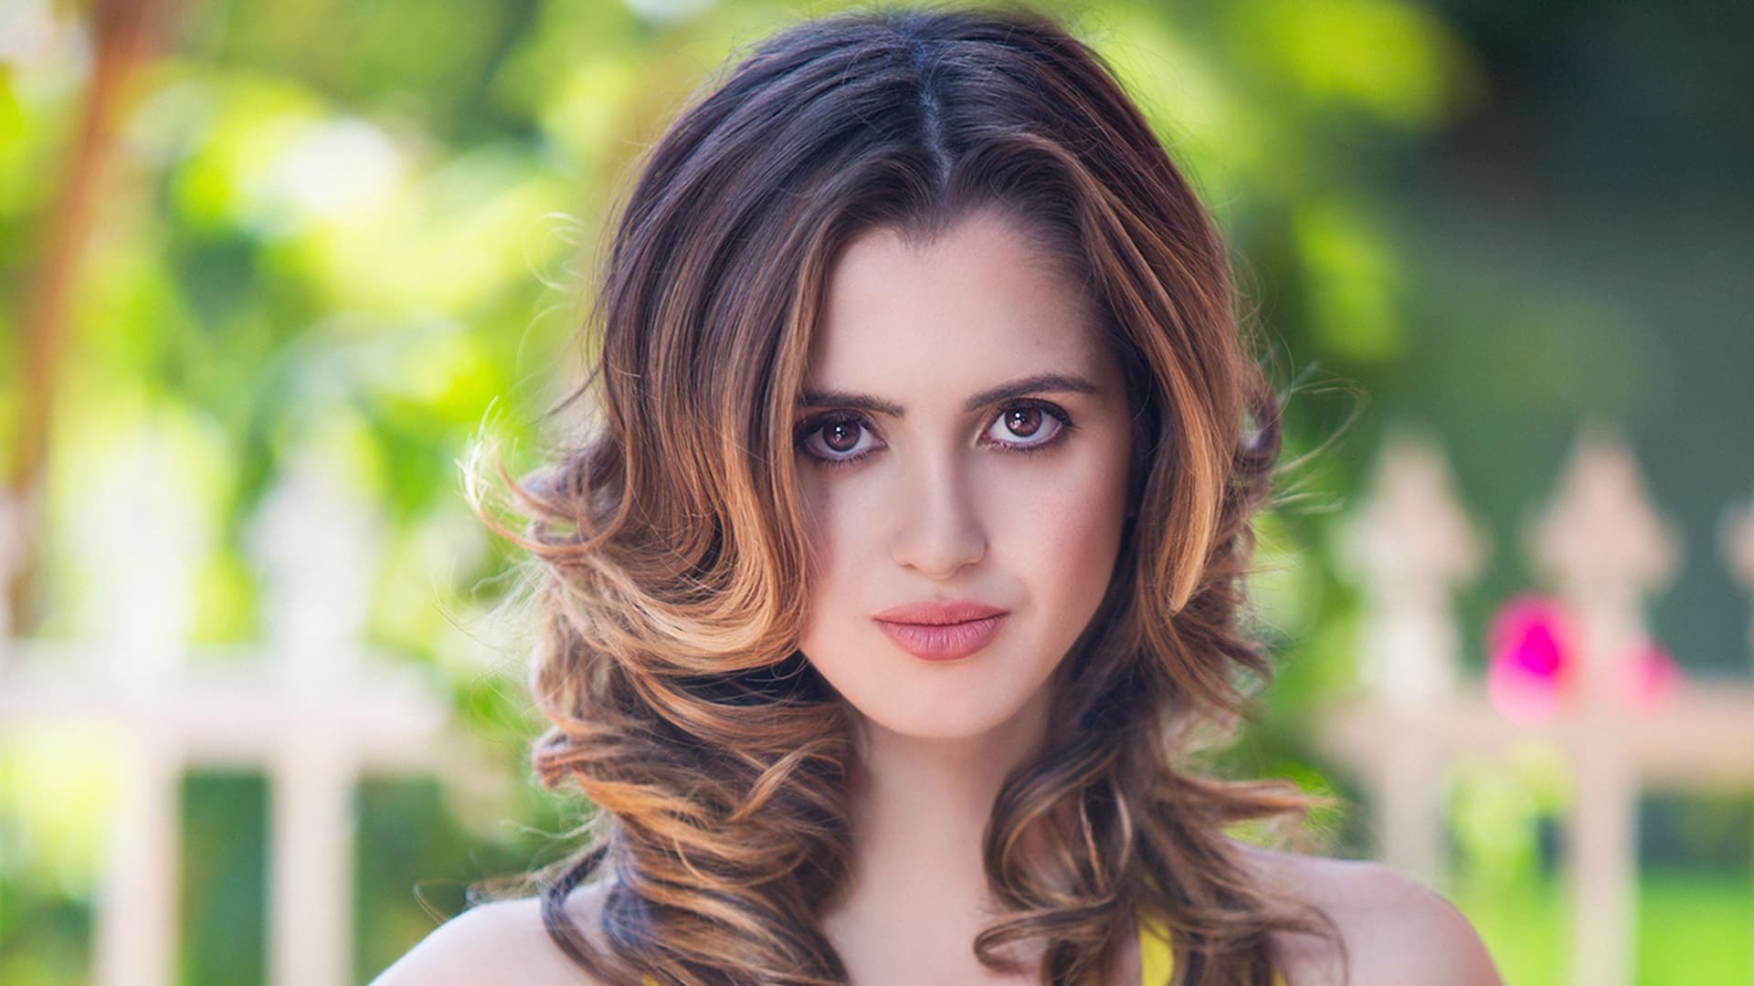
Laura Marano

Slide 56
L C

Slide 57
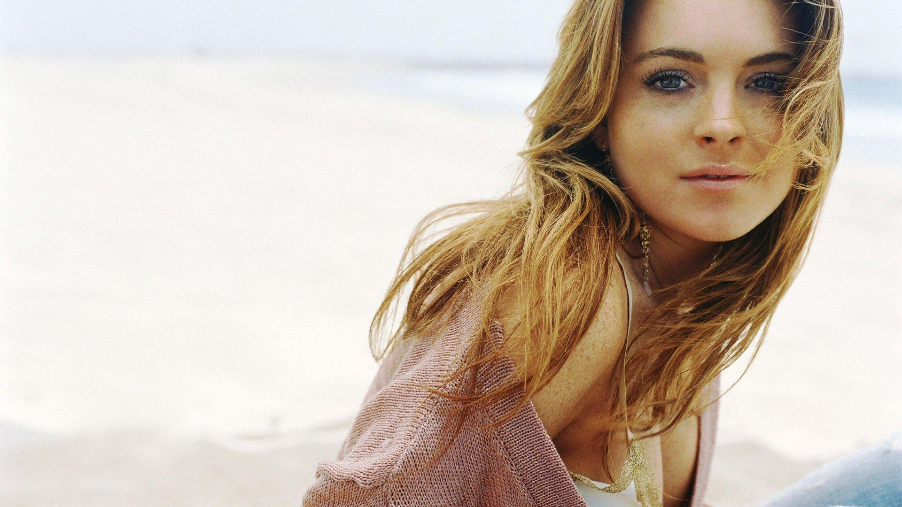
Lindsay Lohan

Slide 58
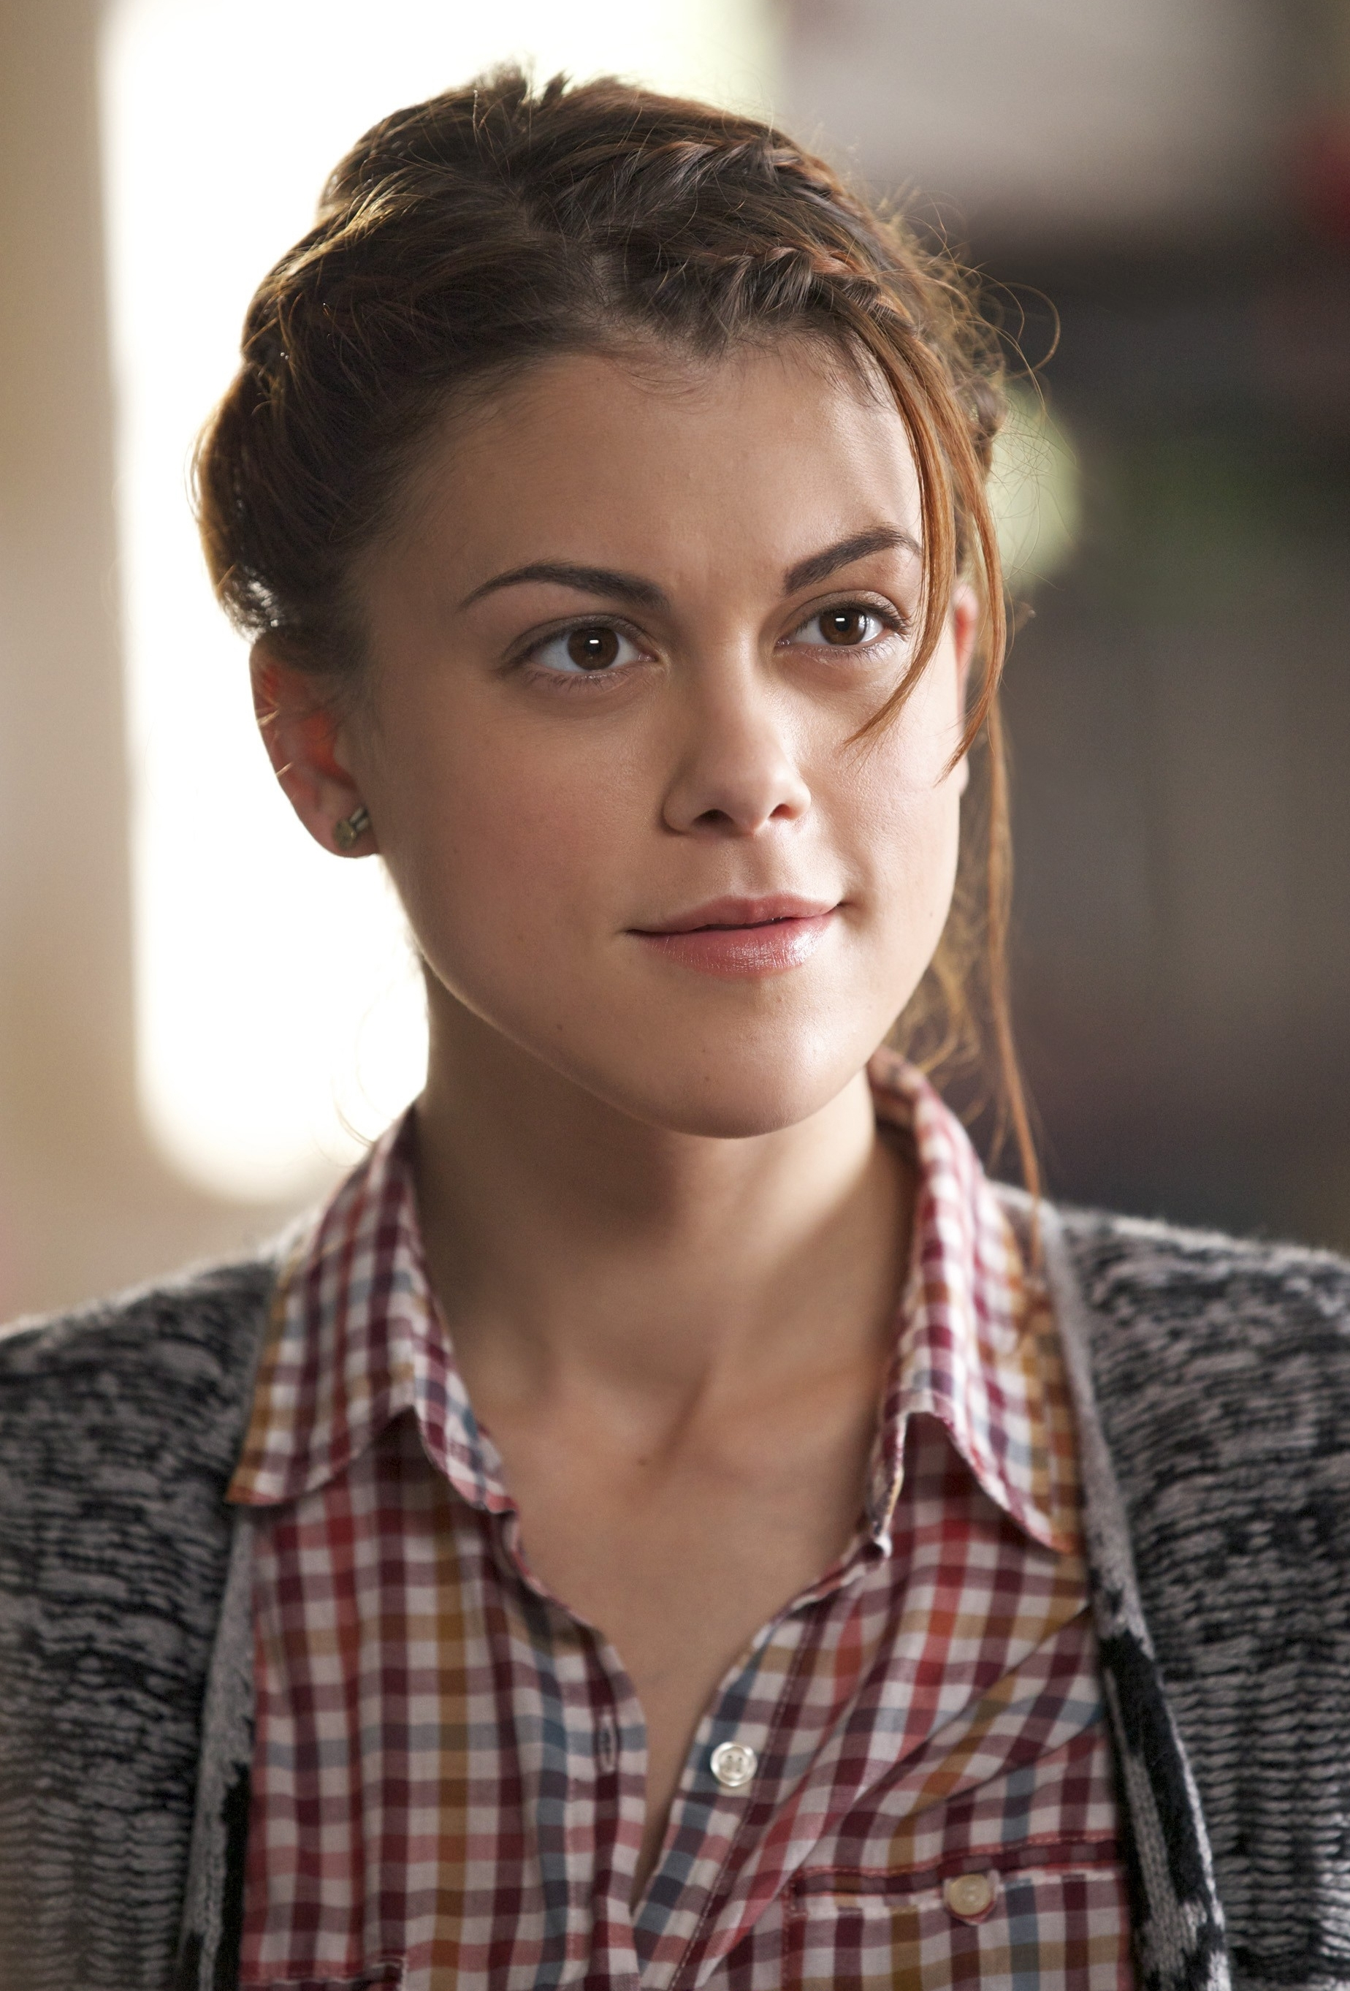
Lindsey Shaw

Slide 59
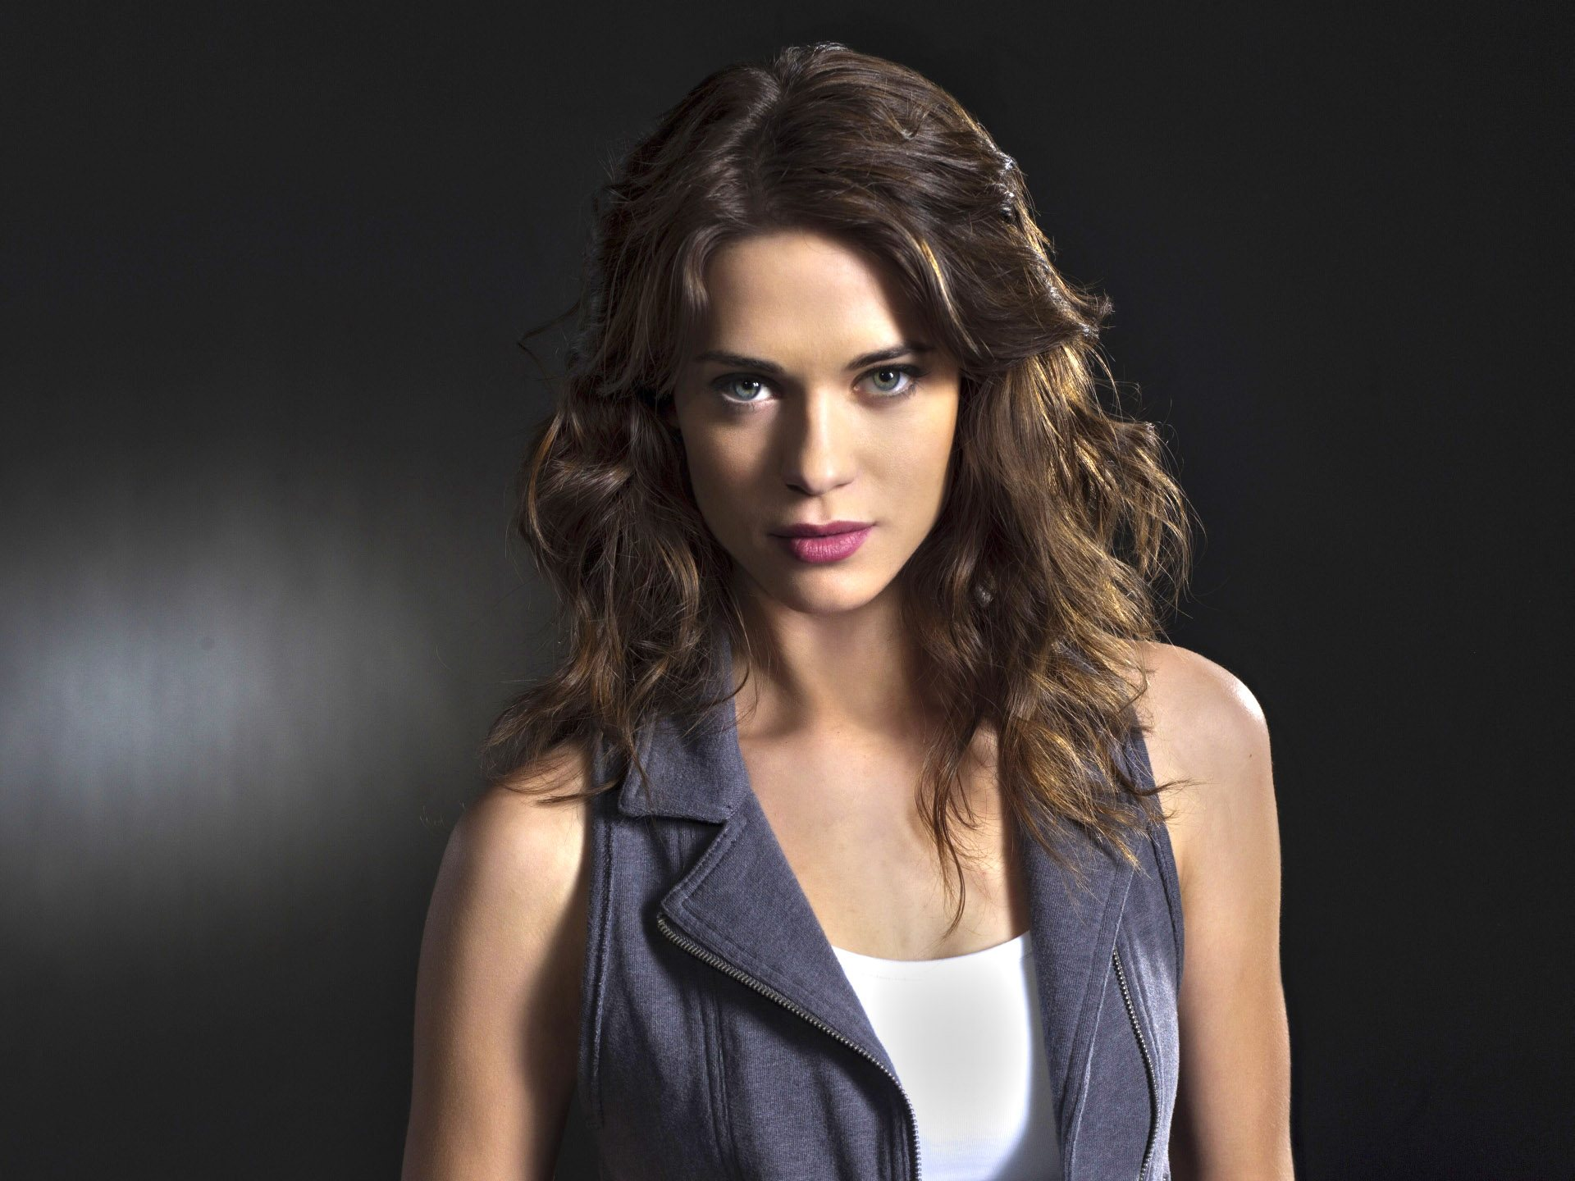
Lyndsy Fonseca

Slide 60
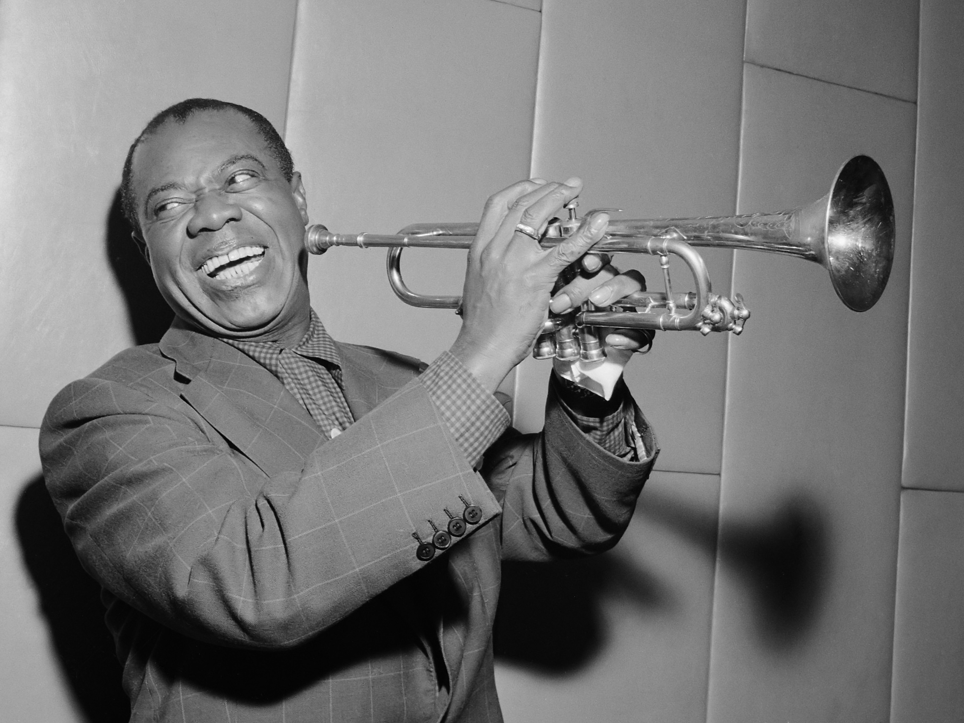
Louis ArmstronG

Slide 61
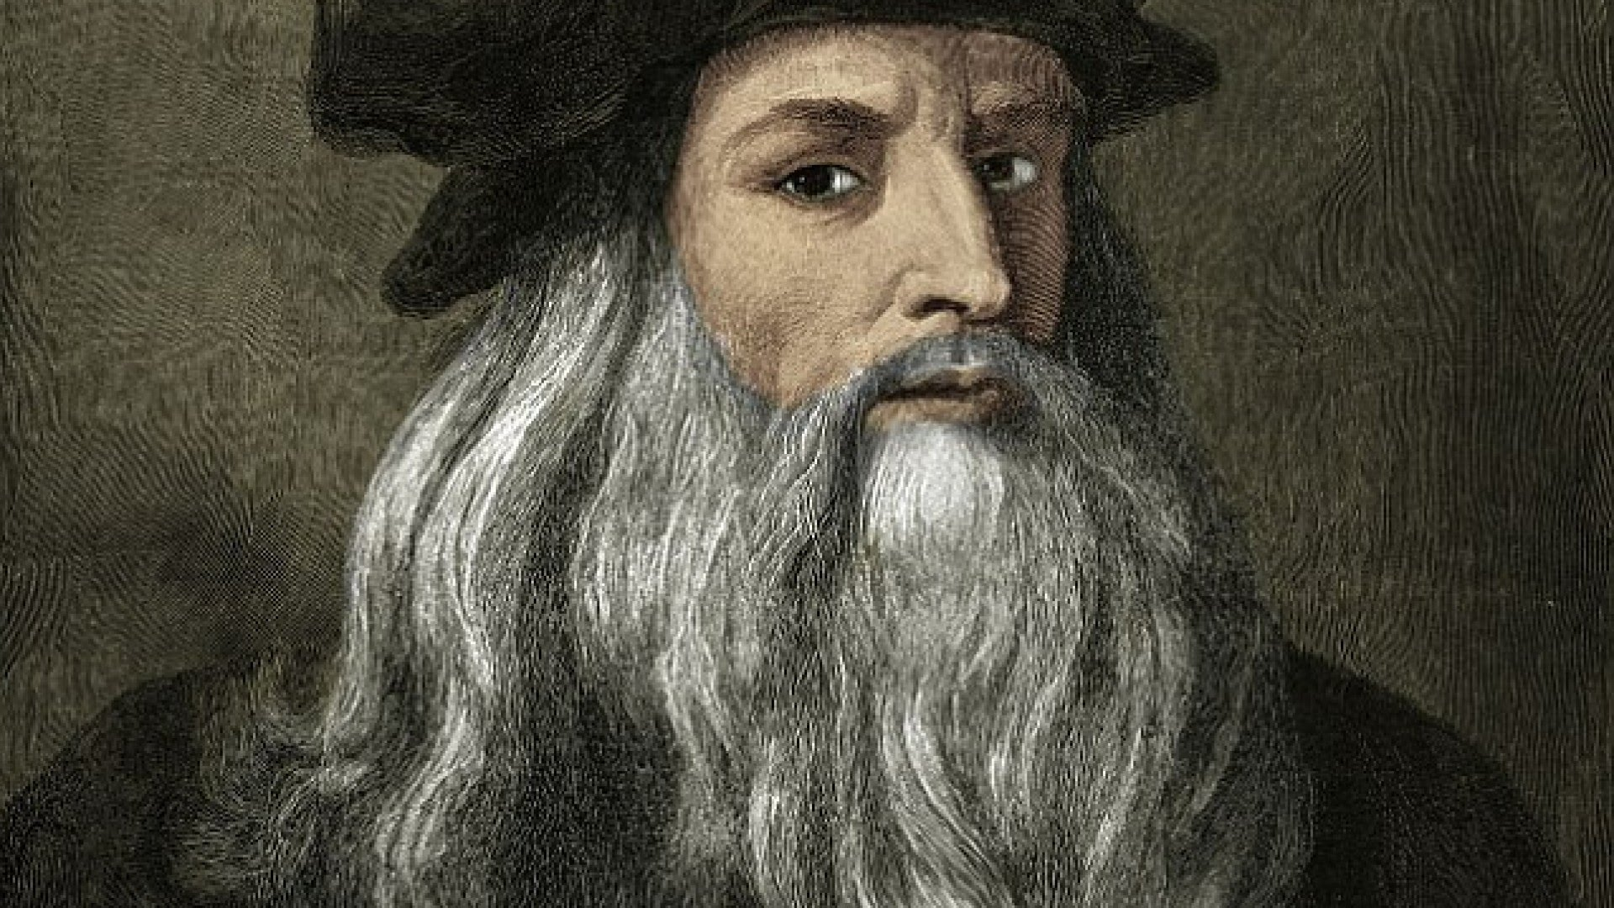
Leonardo da Vinci

Slide 62
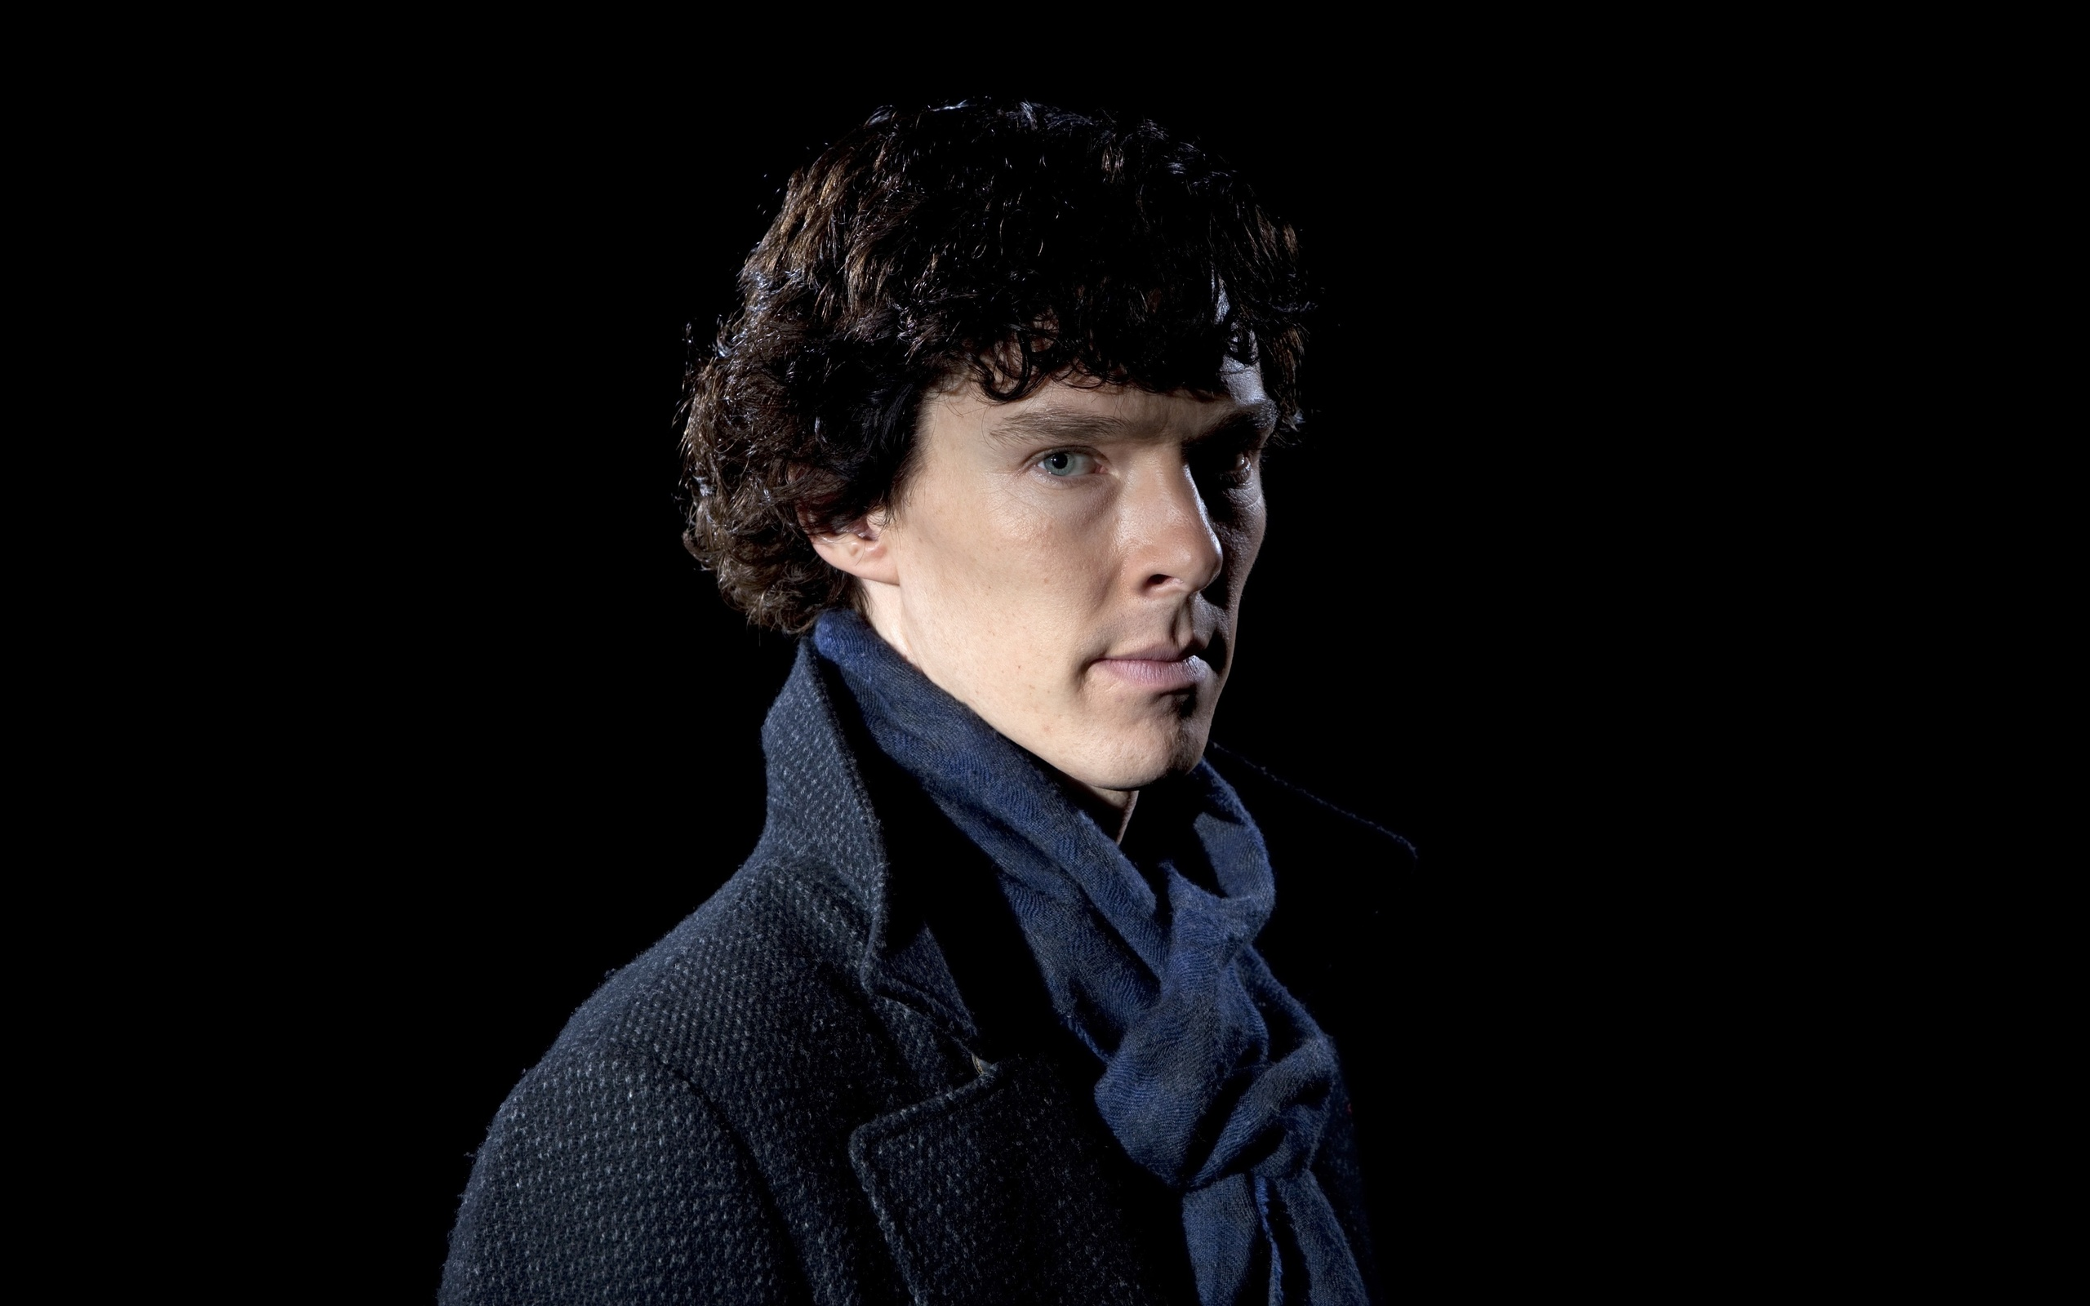
Sherlock Holmes

Slide 63
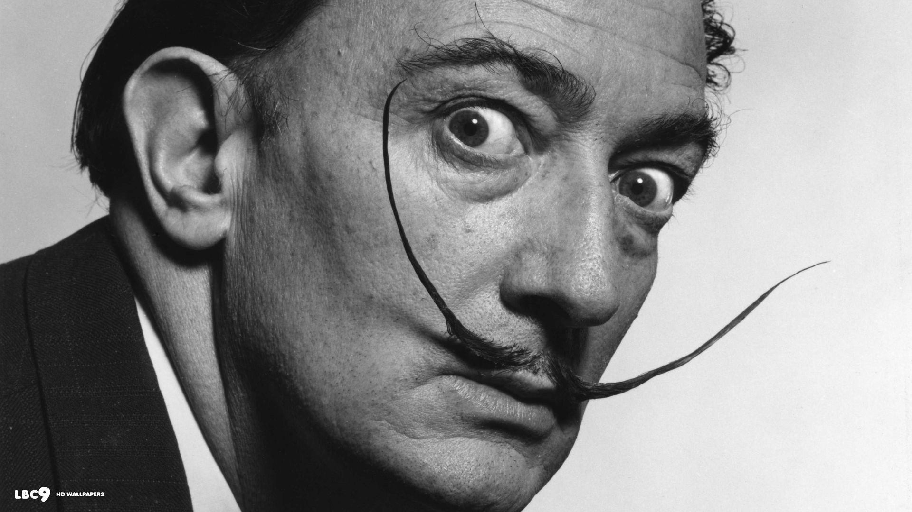
Salvador Dali

Slide 64
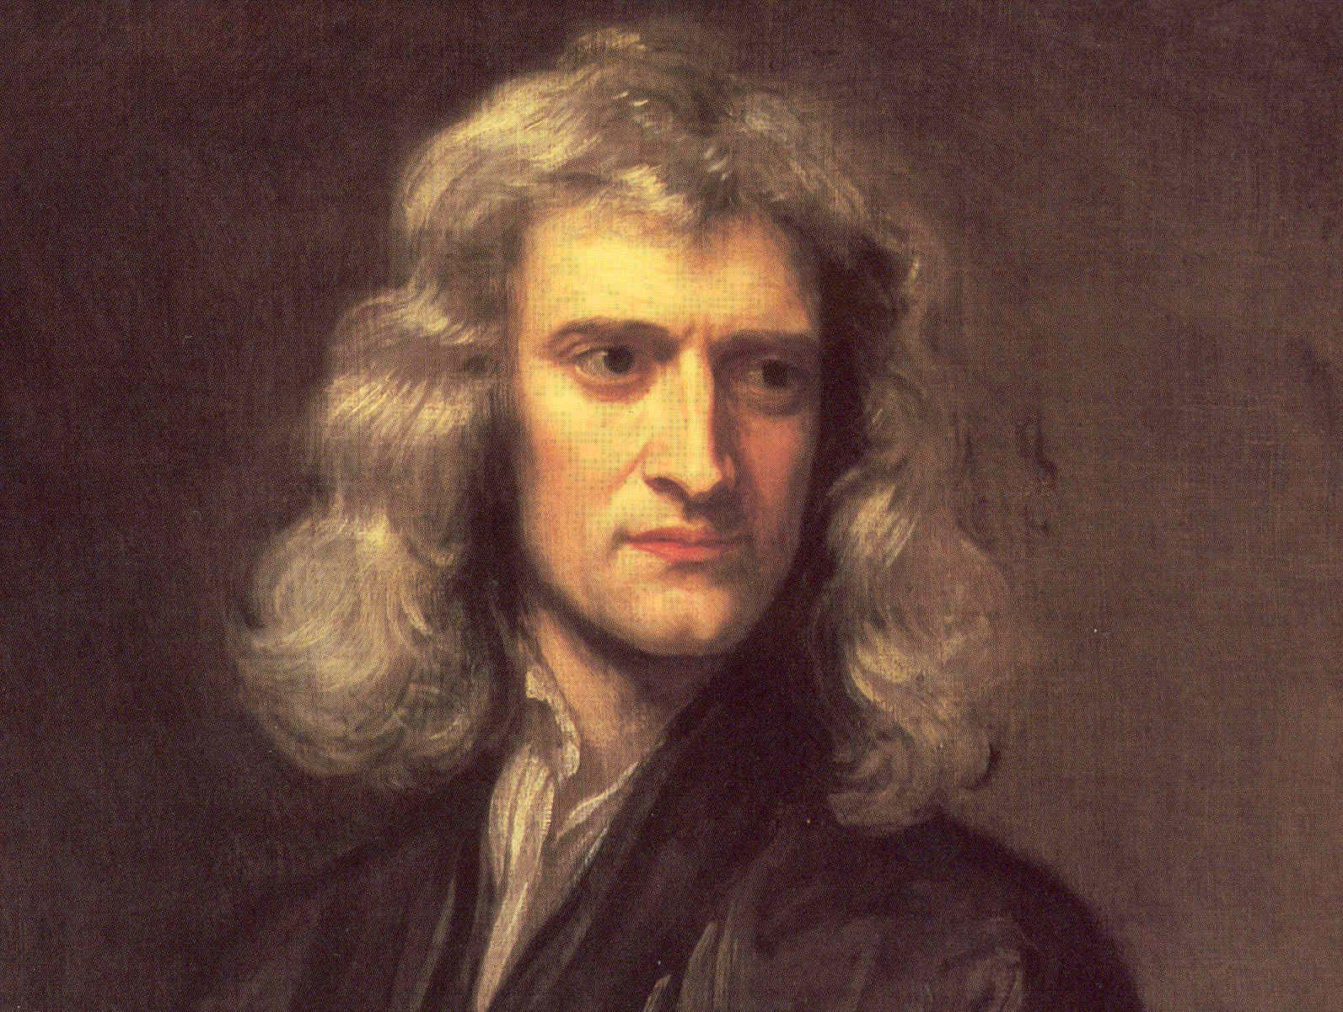
Issac Newton

Slide 65
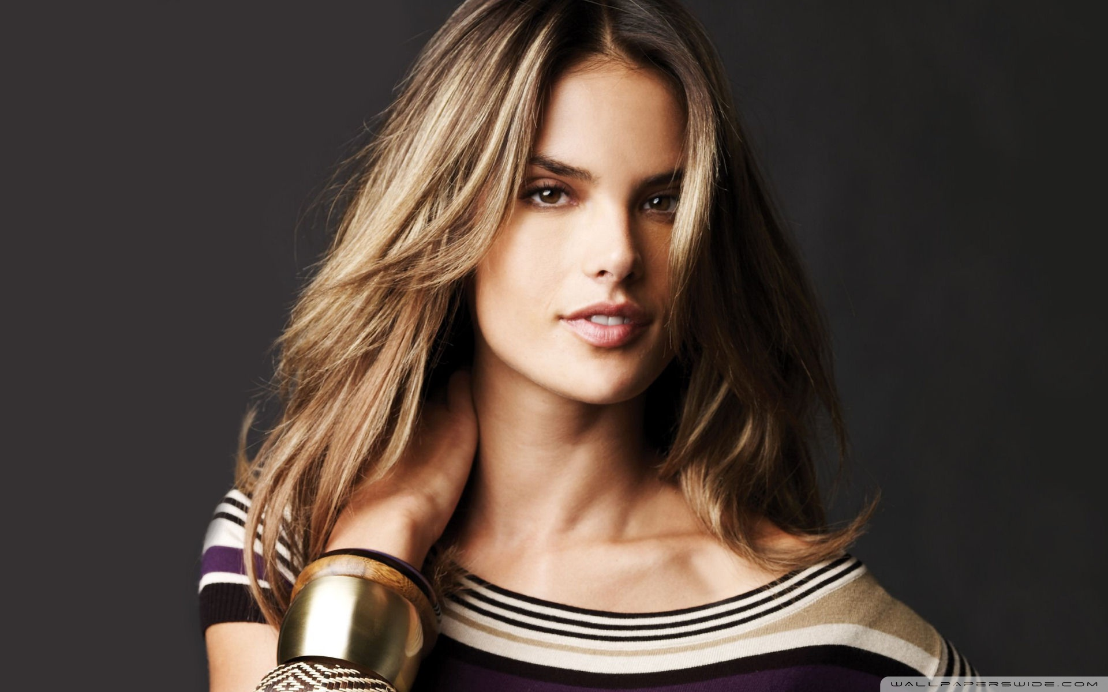
AleSSandra AMbrosio

Slide 66
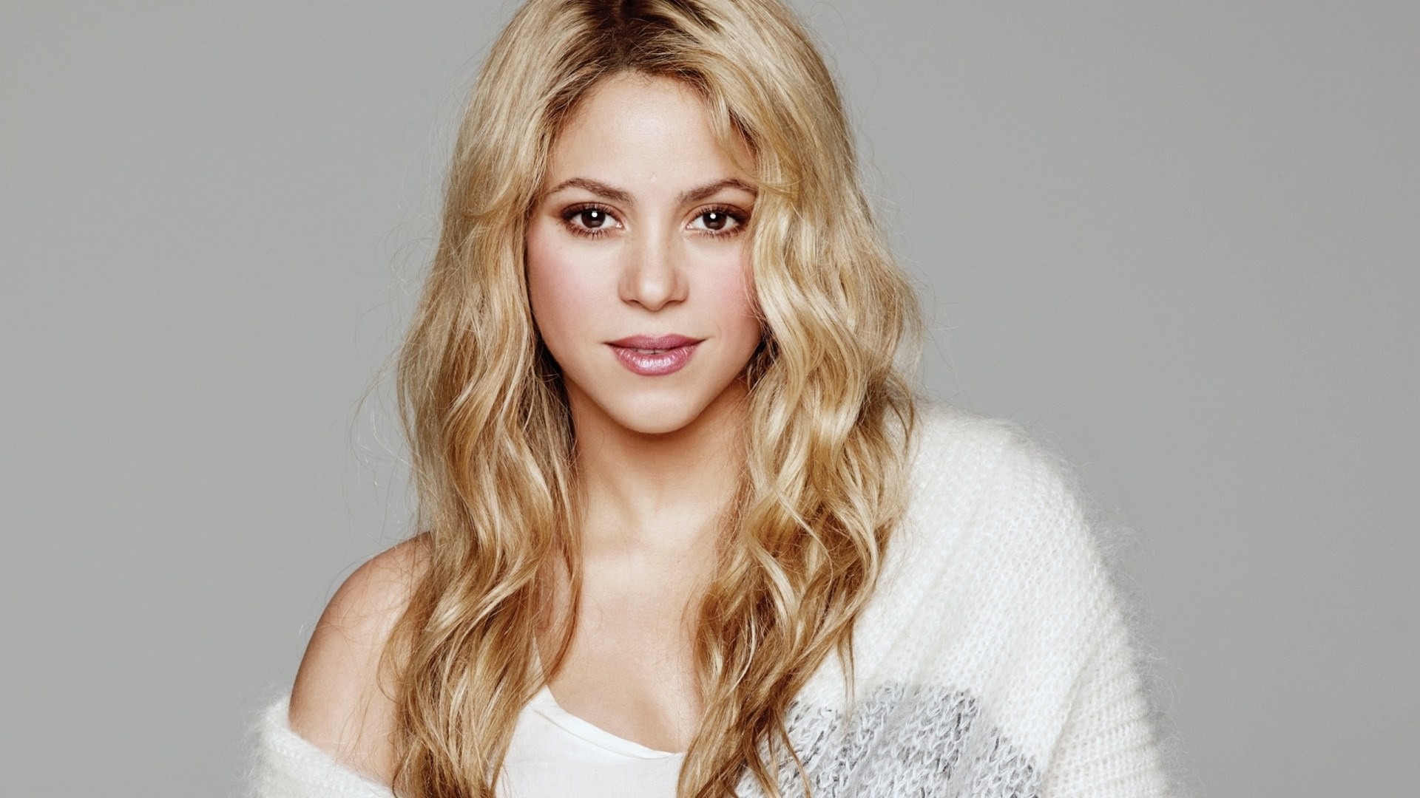
Shakira

Slide 67
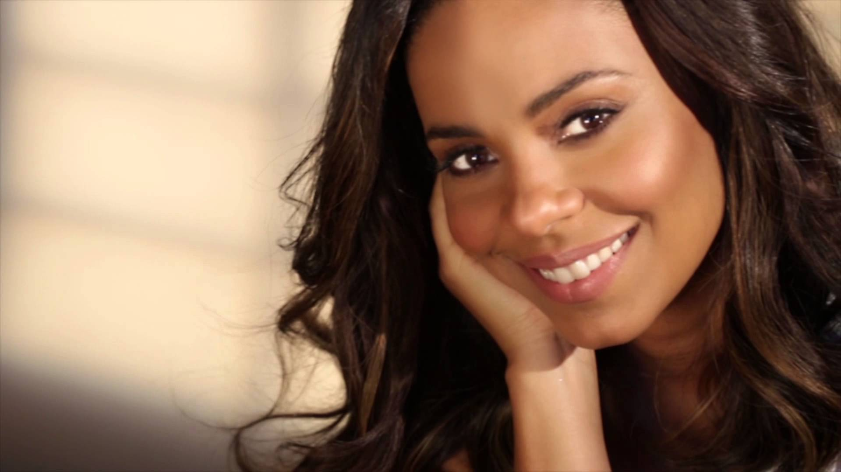
Sanaa Lathan

Slide 68

Severus Snape

